Slide 1

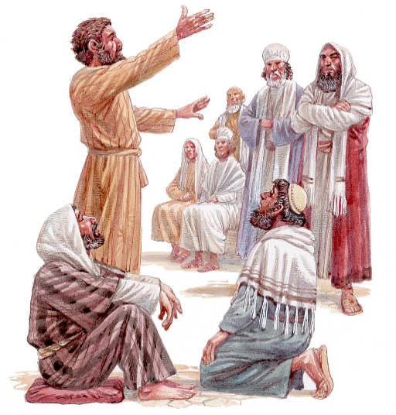
New Testament Survey
The Spread of Christianity

Slide 2
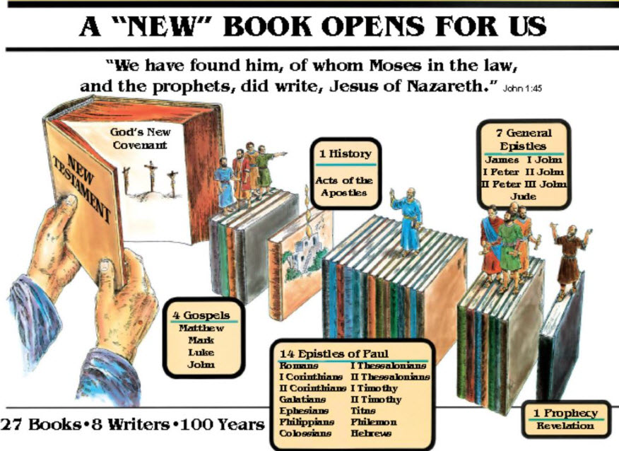

Slide 3
LESSON 4: Book of Acts – The Early Christian Community
Overview of Acts (Continuation of Luke)
1. Spread of Christianity in fulfillment of the ___________________________________ (Ac. 1:8…2= Jerusalem; 6:7= Judea; 9:3= Samaria; 12:24=Gentiles).
2. Vindication of Christianity as rooted in legal ____________. A continuation of _________.
3. Introduction of Paul and the mission to the _______________.
GREAT COMMISSION
JUDAISM
LUKE
GENTILES

Slide 4
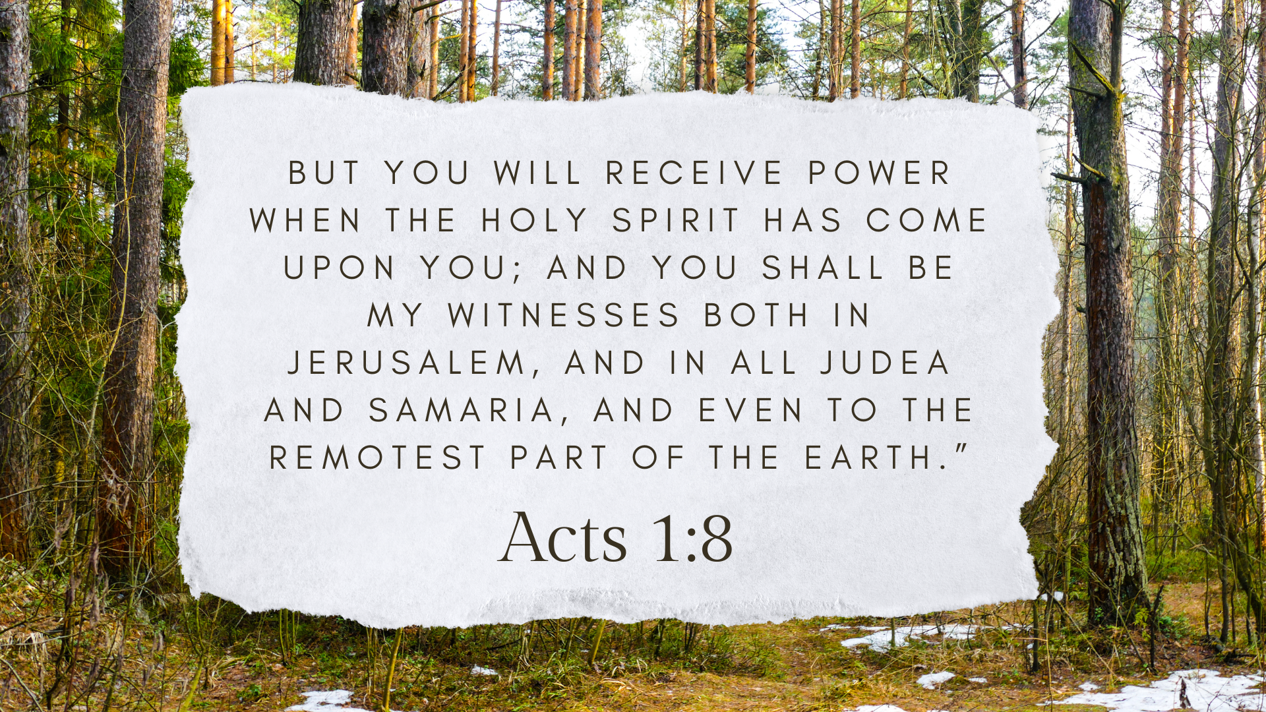

Slide 5
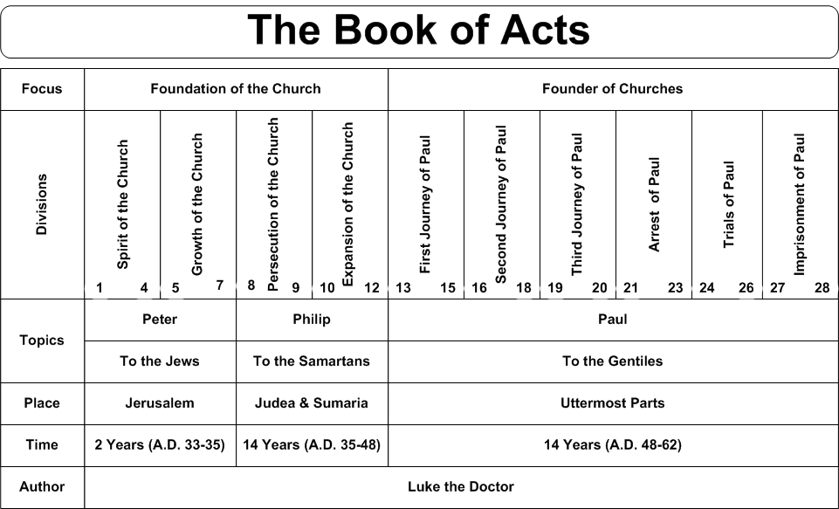
(a) Thematic Outline of Acts

Slide 6
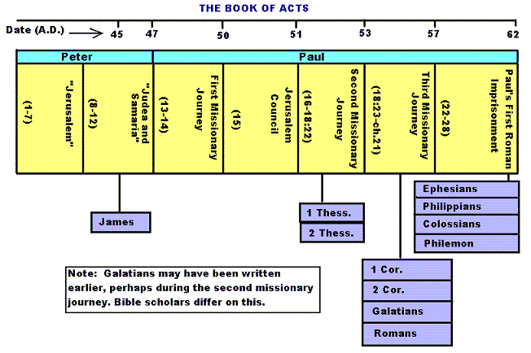
(b) Historical Outline of Acts
Stephen, James Martyred

Slide 7
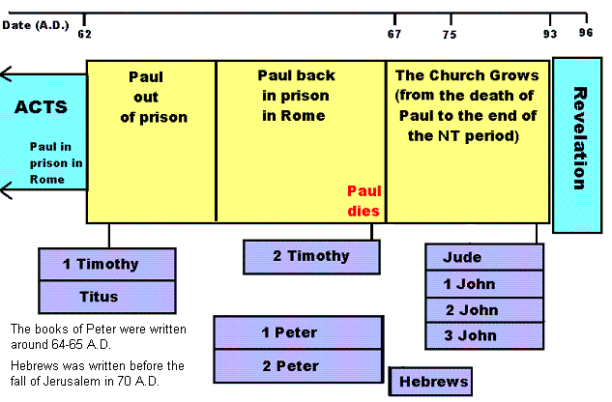
(c) Historical Overview immediately after Acts

Slide 8
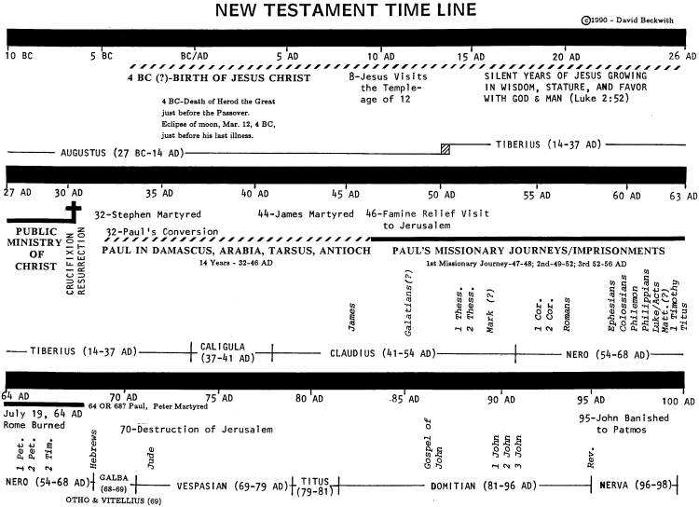

Slide 9
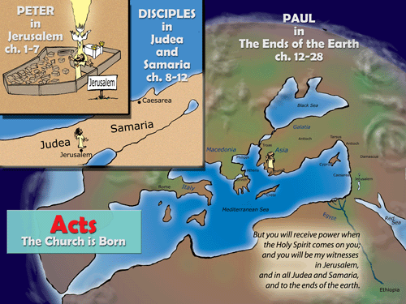

Slide 10



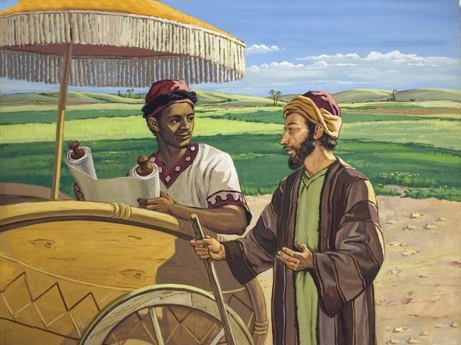
BEFORE PENTECOST AFTER
“And they cast their lots, and the lot fell on Matthias.”
Acts 1:26
“And they were all filled with the Holy Spirit and began to speak with other tongues” Acts 2:4
“Then the Spirit said to Philip, “Go near and overtake this chariot.” Acts 8:29

Slide 11
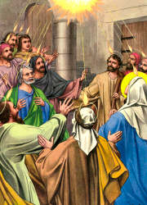
i. The birth of the church (ch. 1,2)
1. ____________________ (2:1-36)
ii. The Jerusalem church (2:41-6:15)
Period of _____________
______________ mounts (3:1-4:31, 5:17-42)
3. Emphasis on ___________ life (2:41-47; 4:31-5:16)
PENTECOST
GROWTH
RESISTANCE
COMMUNITY

Slide 12
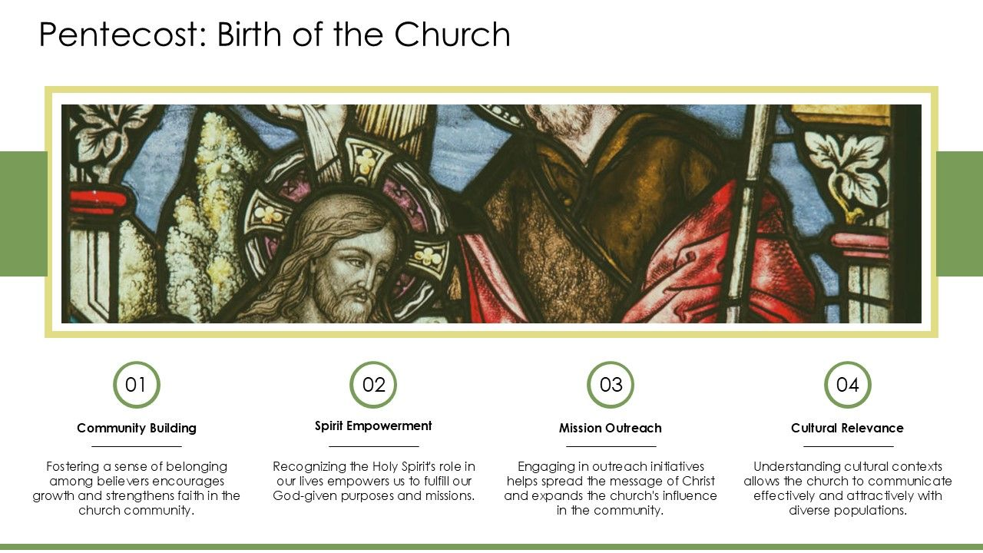
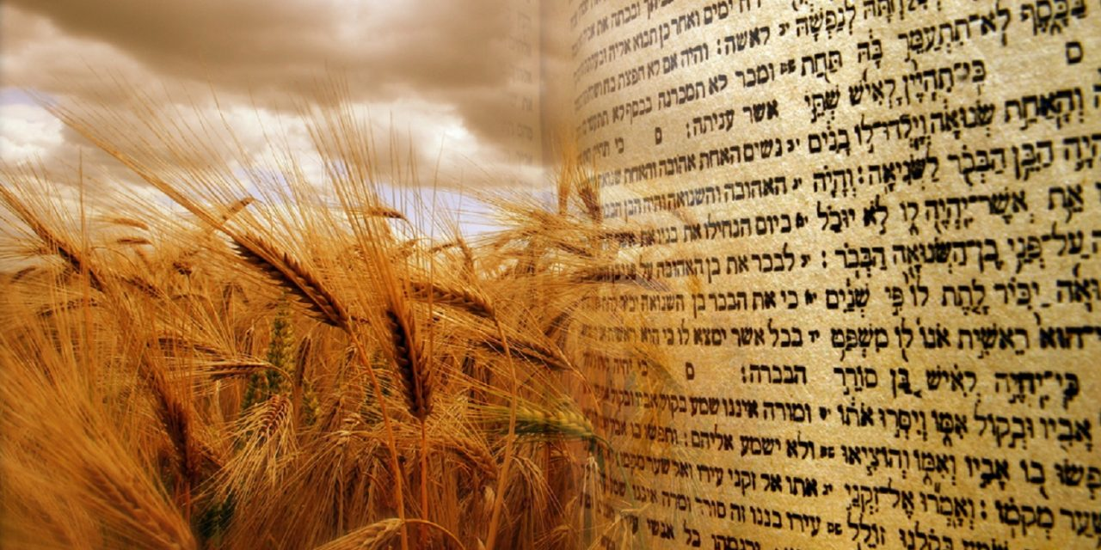
Shavout (Pentecost – 50 days later)
Writing of Law on Sinai (Writing of Law on Hearts – Jeremiah 31:33)
Barley harvest (Harvest of Souls)

Slide 13
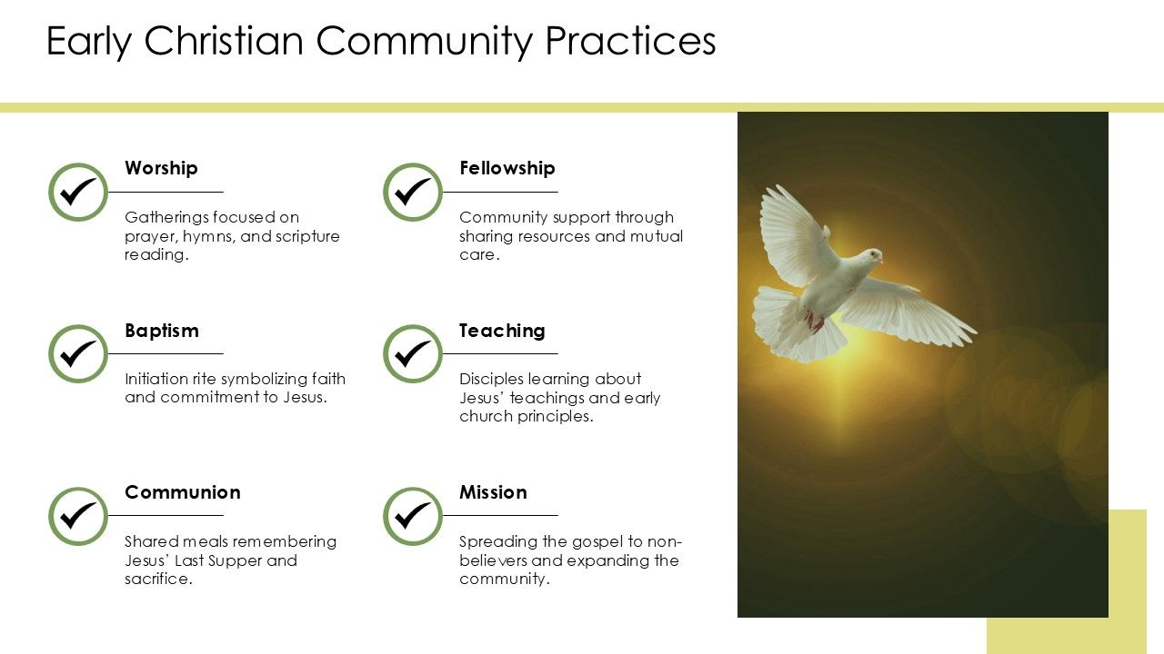
“And they continued steadfastly in the apostles’ doctrine and fellowship, in the breaking of bread, and in prayers.”
Acts 2:42

Slide 14
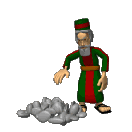
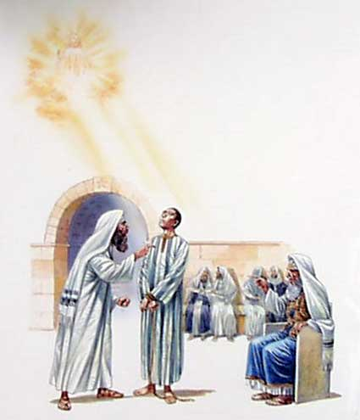
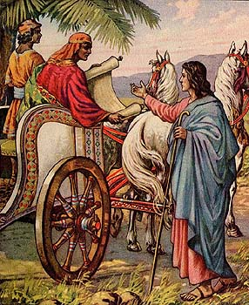
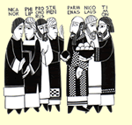
iii. Stephen, Philip and the spread of Christianity outside of Jerusalem
Appointing of Deacons (Acts 6:1-8)
Stephen’s Martyrdom led to a forced exodus from Jerusalem (Acts 7)
Philip witnesses to Samaritans (Acts 8:5-25) and Ethiopian Eunuch.

Slide 15
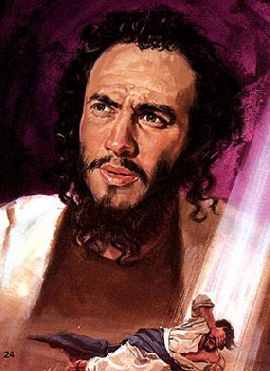
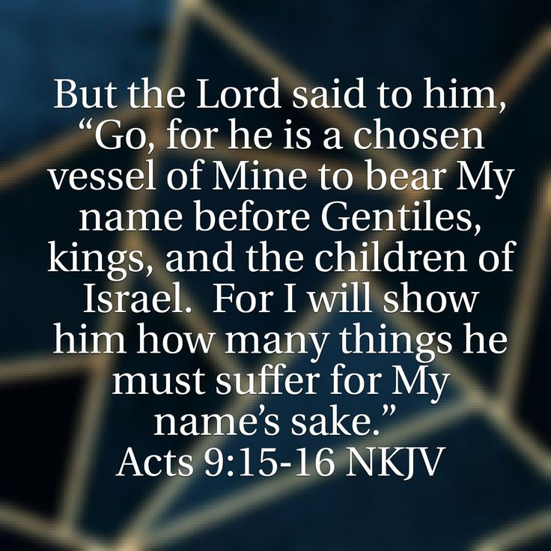
iv. Peter, Paul and the spread of Christianity to the Gentiles
Paul's _____________ and ____________ (9:1-31): Door to the Gentiles seen (peter opens it).
1. Paul’s commission (9:15), 14 years preparation.
2. Peter's ministry to the Gentiles (9:32-10:18)
CONVERSION
COMMISSION

Slide 16
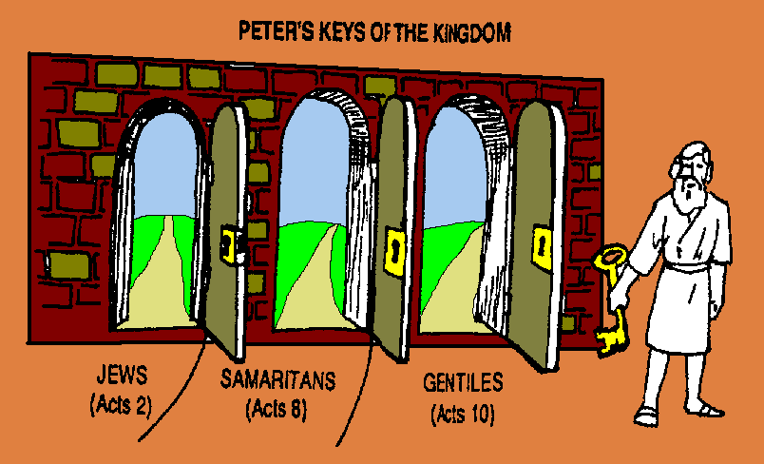
KEYS
Peter used the ______________ to the Kingdom.
“And I will give you the keys of the kingdom of heaven, and whatever you bind on earth will be bound in heaven, and whatever you loose on earth will be loosed in heaven.” Matthew 16:19

Slide 17
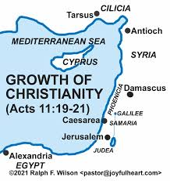
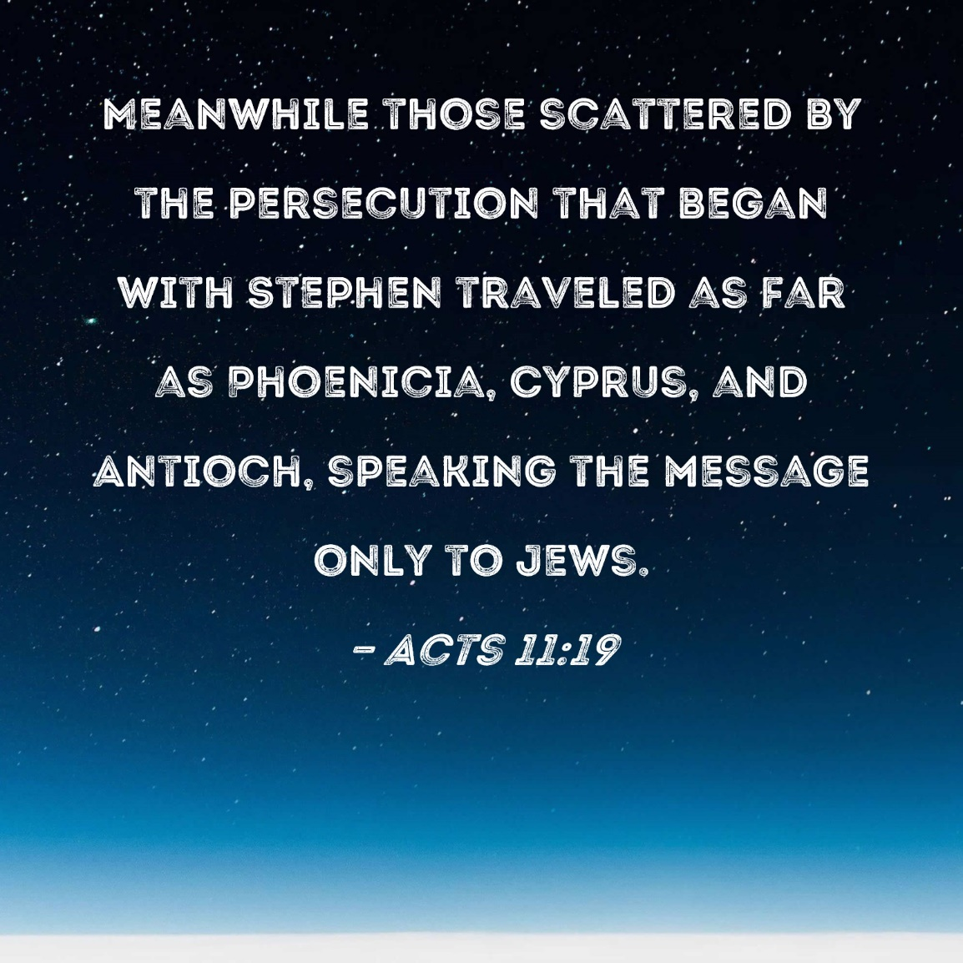
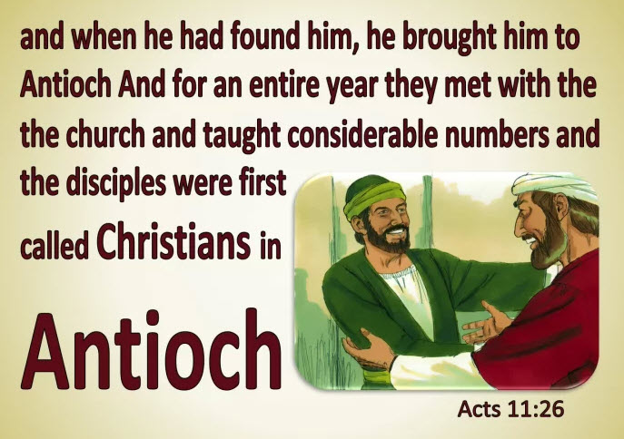

Slide 18
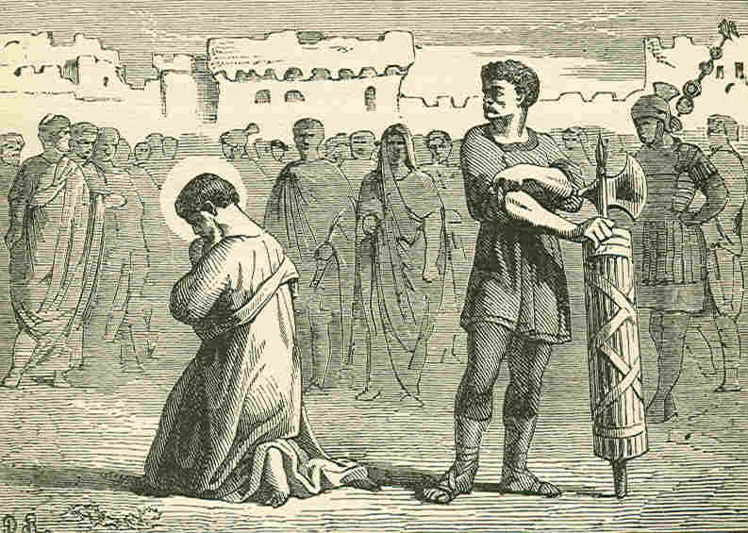
The base for the Christian movement shifted from _____________ to __________. It is from here that the Roman world would be reached for Christ (Acts 11:19-26)
JERUSALEM
ANTIOCH
Resistance in Jerusalem comes to a head with the martyrdom of Apostle James and the imprisonment of Peter by Herod Agrippa I (Acts 12)

Slide 19
Parallels between Peter and Paul
Chapters 1-12 | Chapters 13-24
Jerusalem the center Peter the chief figure Out to Samaria Word rejected by Jews of homeland Peter imprisoned Judgment on Herod | Antioch the center Paul the chief figure Out to Rome Word rejected by Jews of the dispersion Paul imprisoned Judgment on Jews
First Sermon 2 Lame man healed 3 Simon the sorcerer 8 Influence of shadow 5 Laying on of hands 8 Peter worshipped 10 Tabitha raised 9 Peter imprisoned 12 | First Sermon 13 Lame man healed 14 Elymas the sorcerer 13 Influence of handkerchief 19 Laying on of hands 19 Paul worshipped 14 Eutichus raised 20 Paul imprisoned 28

Slide 20
v. Paul’s first missionary
Journey (13:1-15:35)
ANTIOCH
Sent out by the church at ___________ (13:1-3).
2. Cyprus (13:4-12)
3. Asia Minor (13:13-4:28)
Strategy: Urban centers, Synagogues, Paul's central message (13:16-42), to "God fearers" (13:43), established the church in short time –appoint elders.

Slide 21

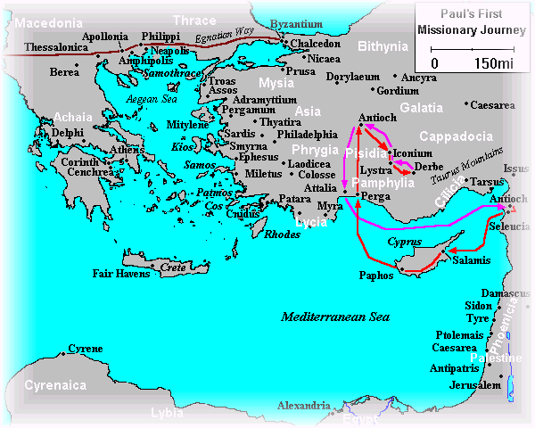
James wrote his letter to Christian Jews (and ultimately all Christians) to emphasize their need for obedient practical works in faith.
Paul wrote Galatians to show man is saved by faith in Jesus Christ alone, not by works (keeping the Law).
James, brother of Jesus, wrote his letter c.AD45 –

Slide 22
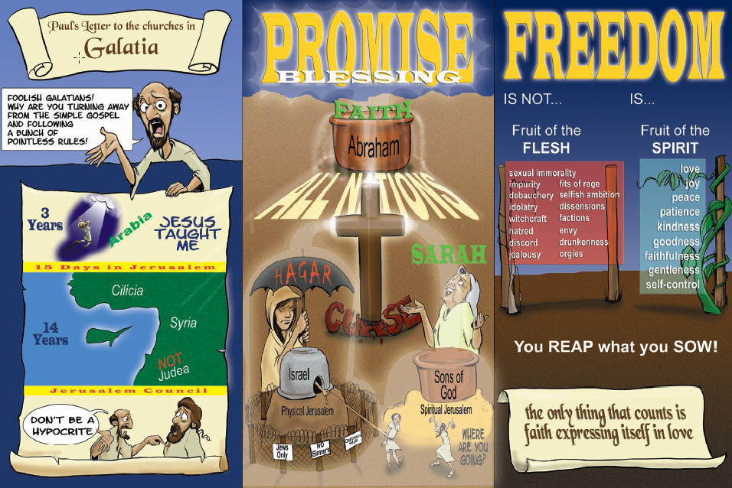
Galatians maybe written from Antioch AD49 to South Galatians before Paul went to Jerusalem Council.

Slide 23
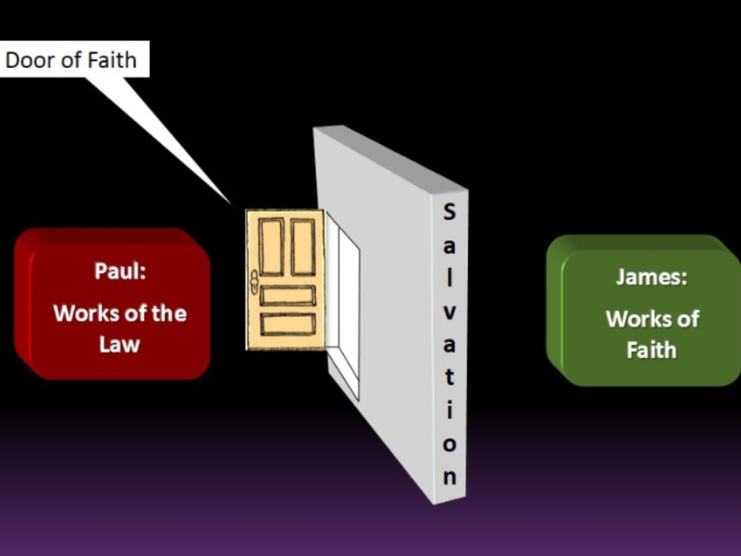
“You see then that a man is justified by works, and not by faith only.”
James 2:24
“Knowing that a man is not justified by the works of the law but by faith in Jesus Christ, even we have believed in Christ Jesus, that we might be justified by faith in Christ and not by the works of the law; for by the works of the law no flesh shall be justified.” Galatians 2:16

Slide 24
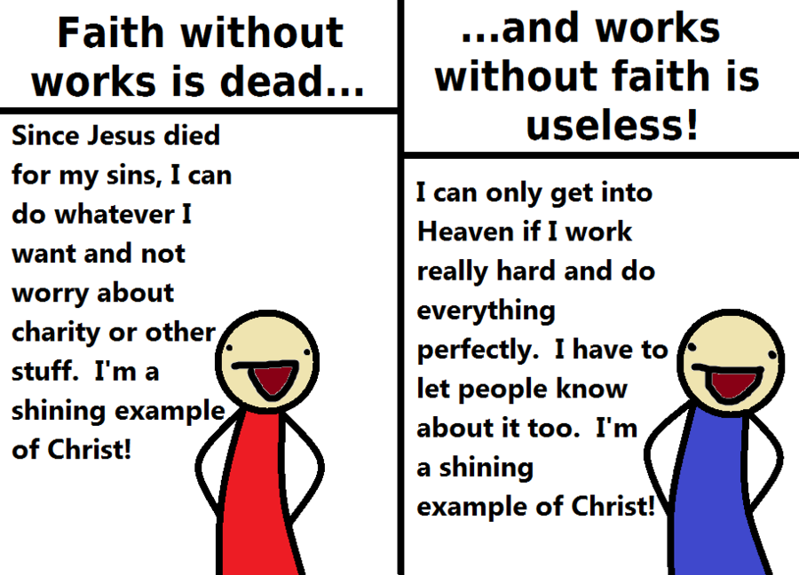
James counters this view
Galatians counters this view

Slide 25
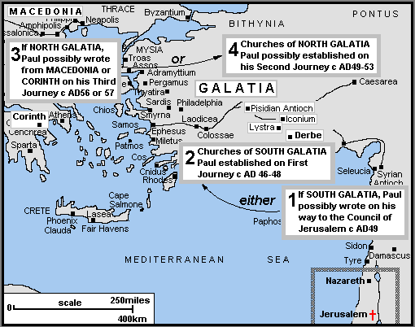
North and South Galatia Theories

Slide 26
vi. Jerusalem Council (15:1-35)
Question: What is the relationship of Christianity to_____________________?
a. Position of the Judaizers (15:1,5).
b. Testimony of Peter (15:7-12).
c. Findings summarized by James, step brother of Jesus (15:13-29)
THE MOSAIC LAW

Slide 27
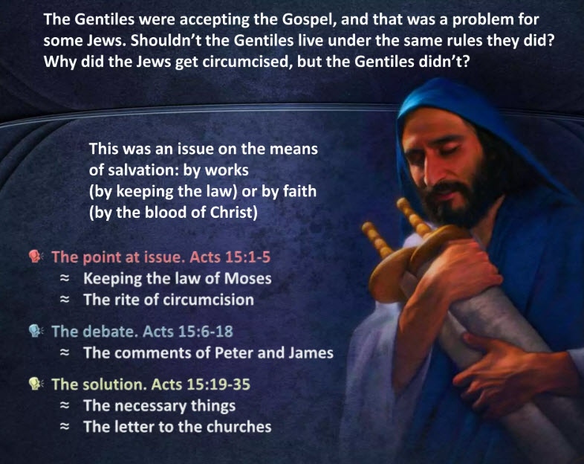

Slide 28
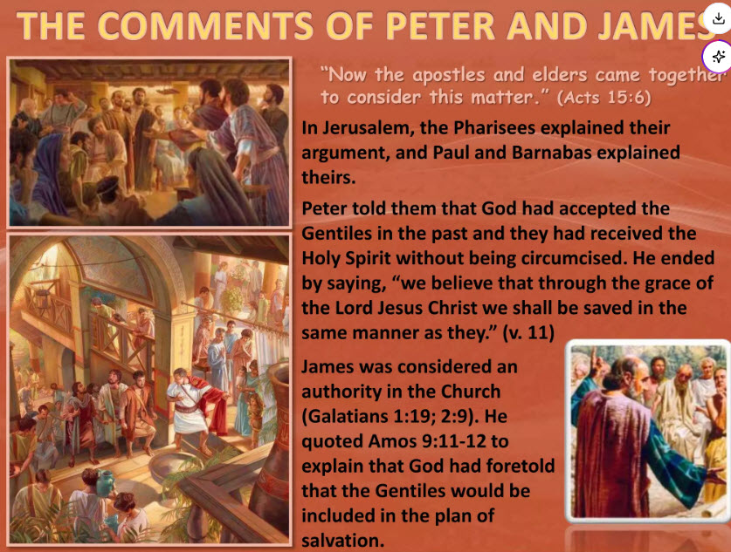

Slide 29
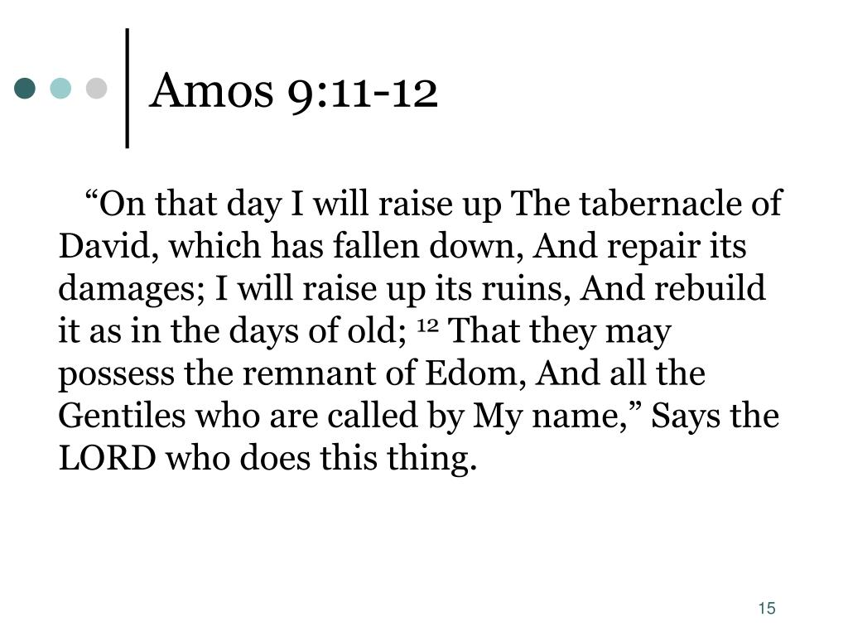
Continue line of David through the Messiah (Jesus) and see His Kingdom come among the Gentiles with free worship as was in David’s Tabernacle (not legalistic).

Slide 30
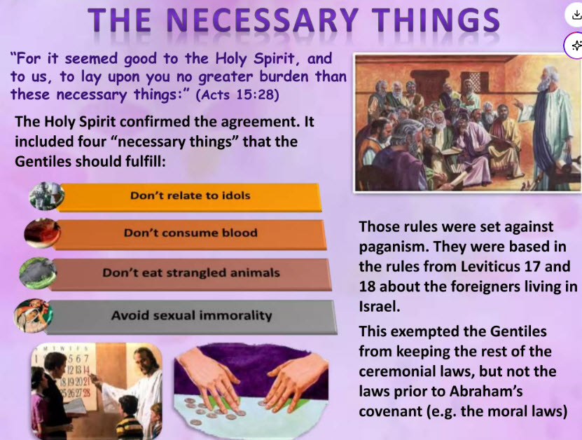

Slide 31
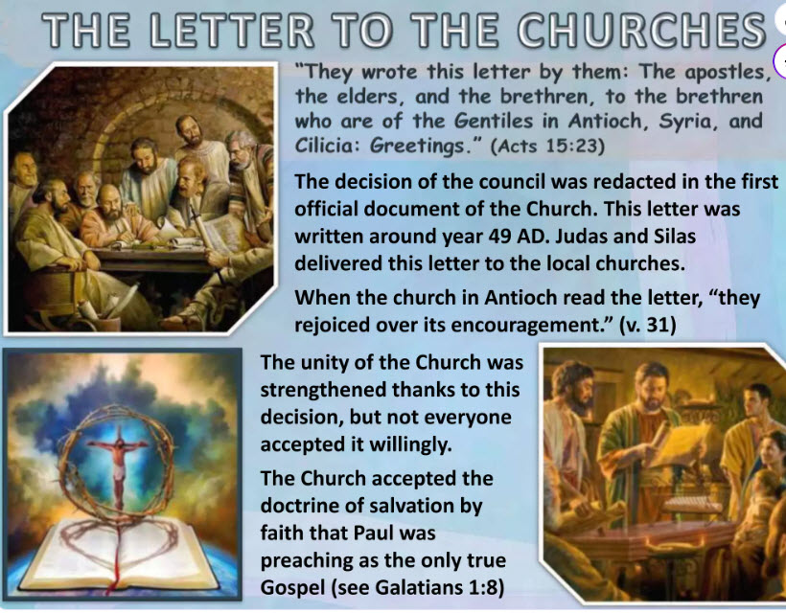

Slide 32
New Testament Survey
The Spread of Christianity

Slide 33
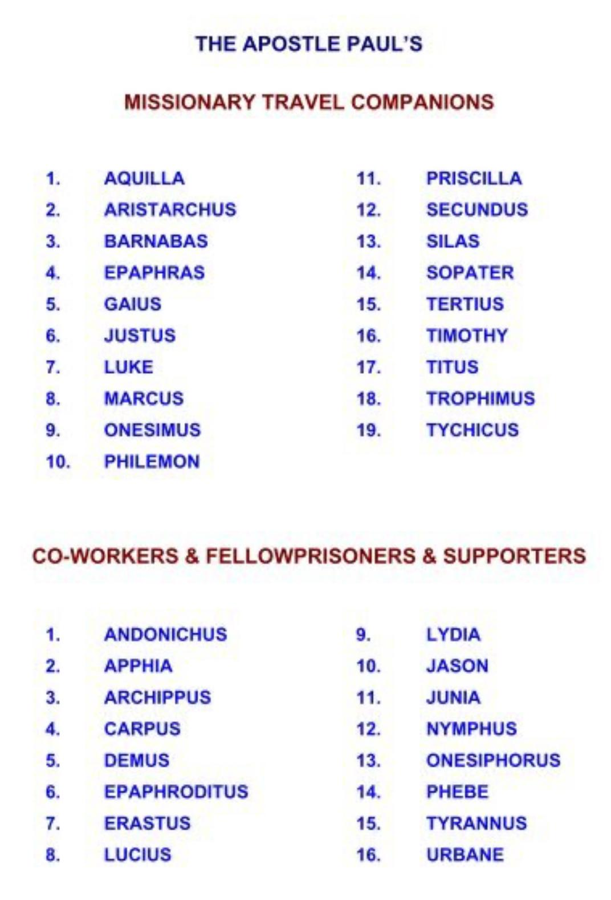
LESSON 5: Paul’s Further Missionary Journeys
i. Second Missionary Journey (Acts 15:36-18:22)
BARNABAS
A parting of the ways between ______________ and Paul over John Mark.
Asia Minor (Turkey) and Greece – Holy spirit directs them from Asia to Europe (Lydia first European convert).
1. The __________________ band
2. Growing _________________(Ac. 17:1-9; 18:12-18) – hostility from Jews increases.
From Thessalonica to Athens - Ac. 17:16-34.
Paul at Corinth (Acts 18:1-17) – 1 year 6 months
APOSTOLIC
POLARIZATION

Slide 34
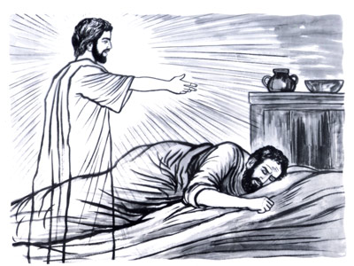
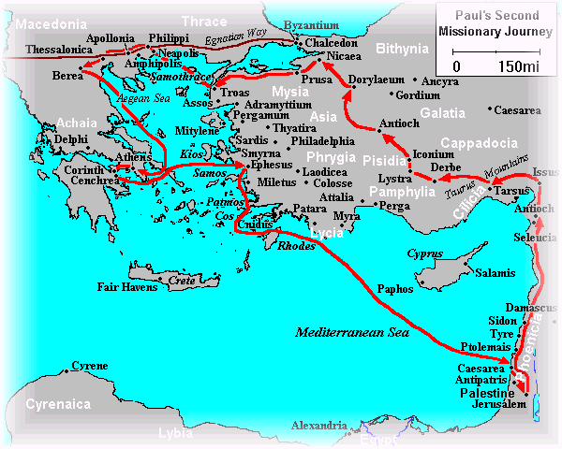
⁶ Now when they had gone through Phrygia and the region of Galatia, they were forbidden by the Holy Spirit to preach the word in Asia. ⁷ After they had come to Mysia, they tried to go into Bithynia, but the Spirit did not permit them. ⁸ So passing by Mysia, they came down to Troas. ⁹ And a vision appeared to Paul in the night. A man of Macedonia stood and pleaded with him, saying, “Come over to Macedonia and help us.” Acts 16:6-10

Slide 35
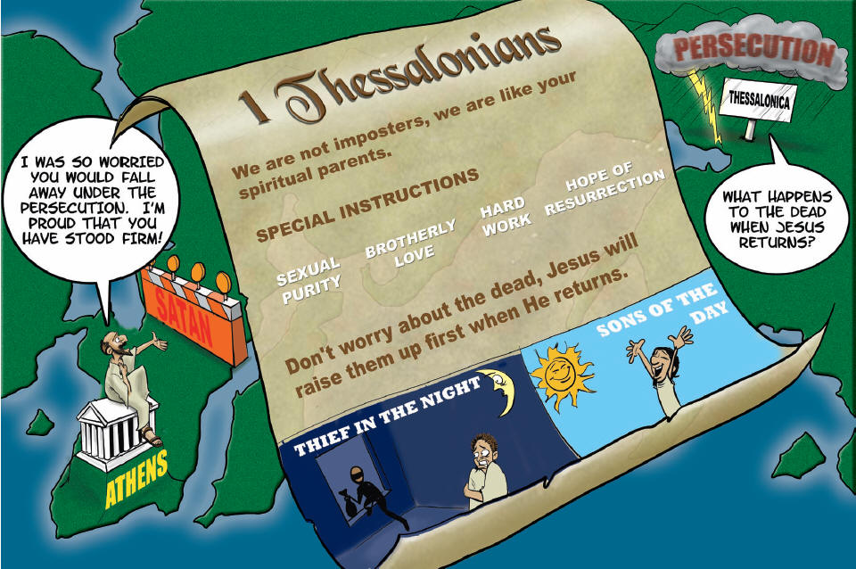
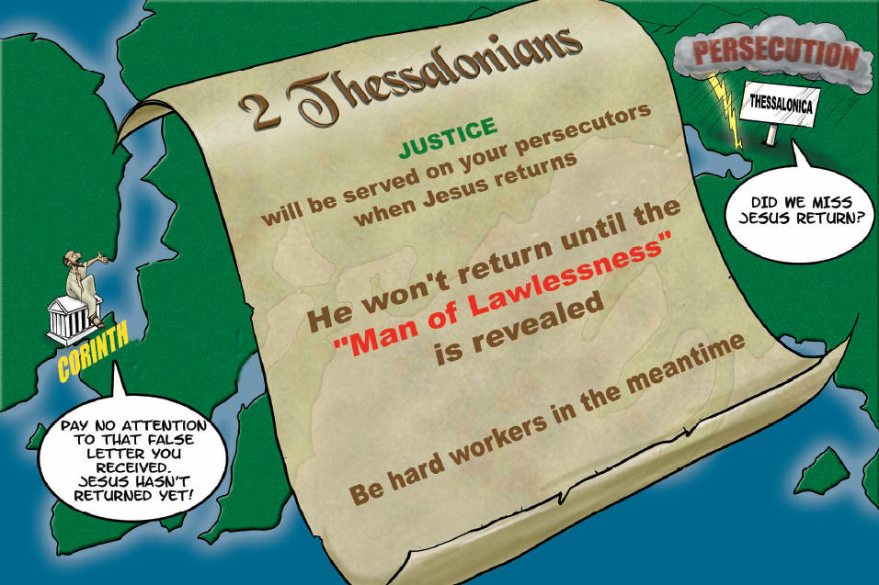
First Thessalonians: _________________ in light of Christ’s return.
Second Thessalonians: Understanding the _______________.
HOLINESS
DAY OF THE LORD
Both First and Second Thessalonians were written by Paul in c.AD.51 from Athens and Corinth respectively.
MARK possibly written cAD52 from Rome

Slide 36
Acts 17
Acts 16
Acts 18

Slide 37
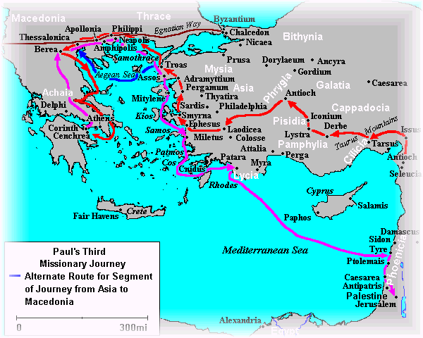
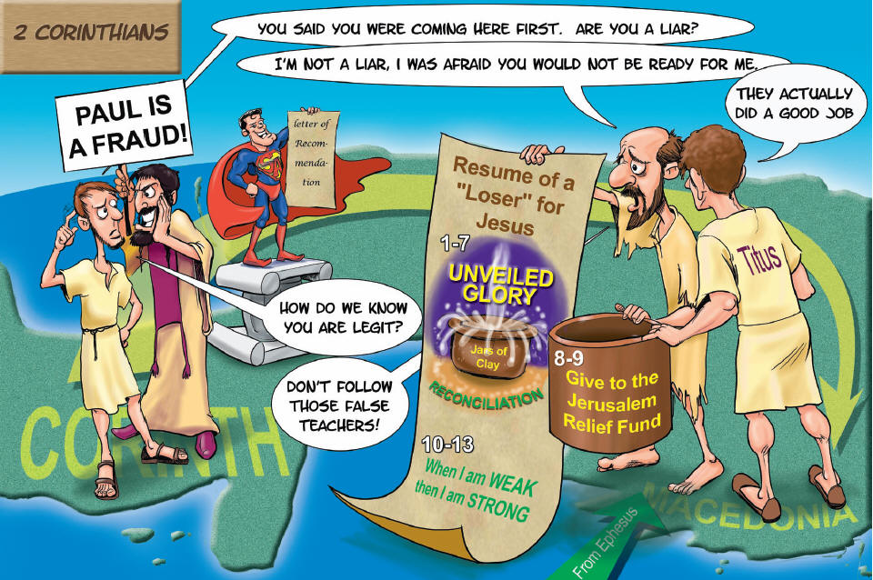
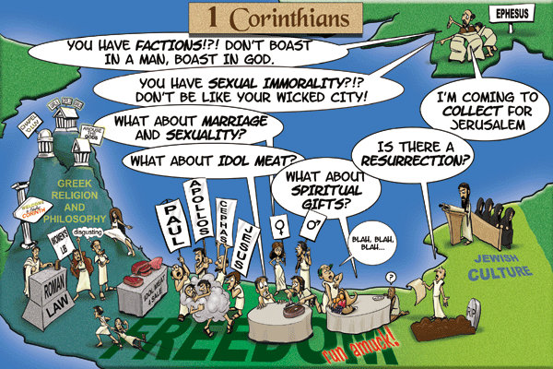
Third Missionary Journey (Acts 18:23-21-14)
Romans written by Paul from Corinth c.AD57
First Corinthians: Correction of ________________ living in Church life.
Second Corinthians: Paul’s defense of the _____________________.
Romans: The _______________________ of God
CARNAL
MINISTRY
RIGHTEOUSNESS
Second Corinthians written probably from Phillipi by Paul in c.AD56.
Paul stayed 2 years in Ephesus. First Corinthians written from Ephesus c.AD56.

Slide 38
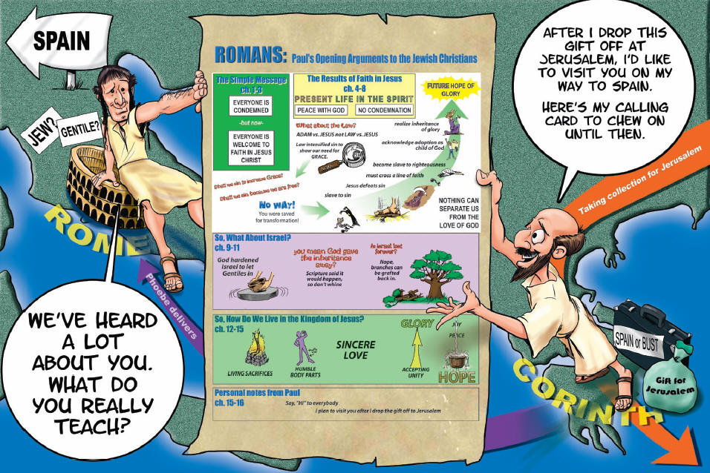
I, Tertius, who wrote down this letter, greet you in the Lord (16:22)

Slide 39
Third Missionary Journey (Acts 18:23-21-14)
Acts 20
Acts 19
Acts 21

Slide 40
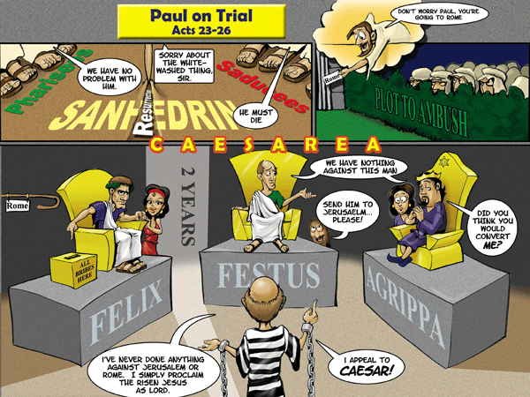
Acts 22-26

Slide 41
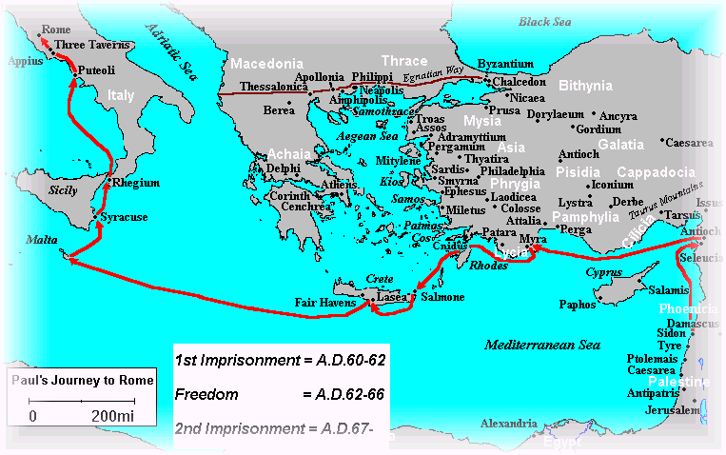
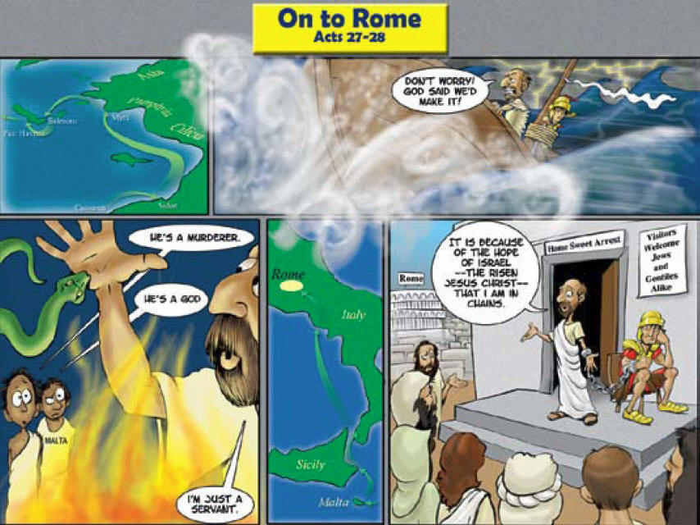
Paul's trek to Rome (Acts 20:2-28:31)
iii. Paul’s Trek to Rome (Acts 27:2-28:31)
Freedom
First Timothy written from Macedonia to Timothy in Ephesus.
1st Imprisonment
Paul wrote the ‘Prison Epistles’ (Ephesians, Colossians, Philippians and Philemon) from Prison in Rome.
Titus was written by Paul from Corinth before his trip to Spain (AD63)
Second Imprisonment
Second Timothy was last letter of Paul before he was executed.

Slide 42
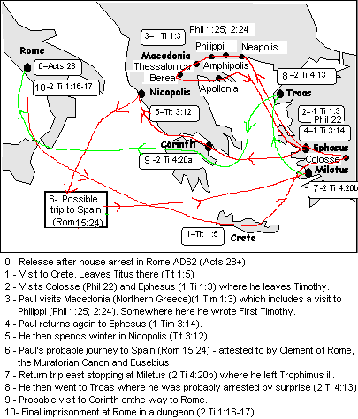
Wrote Letter to Titus

Slide 43
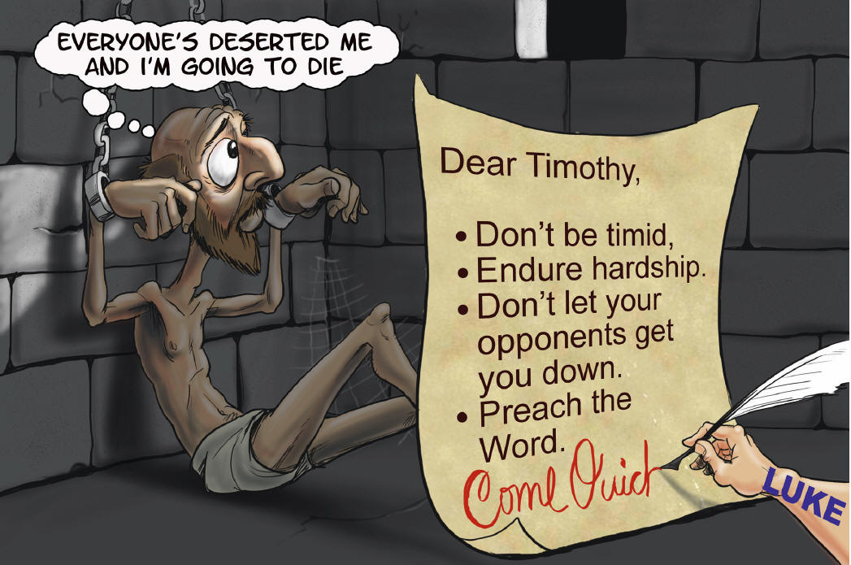
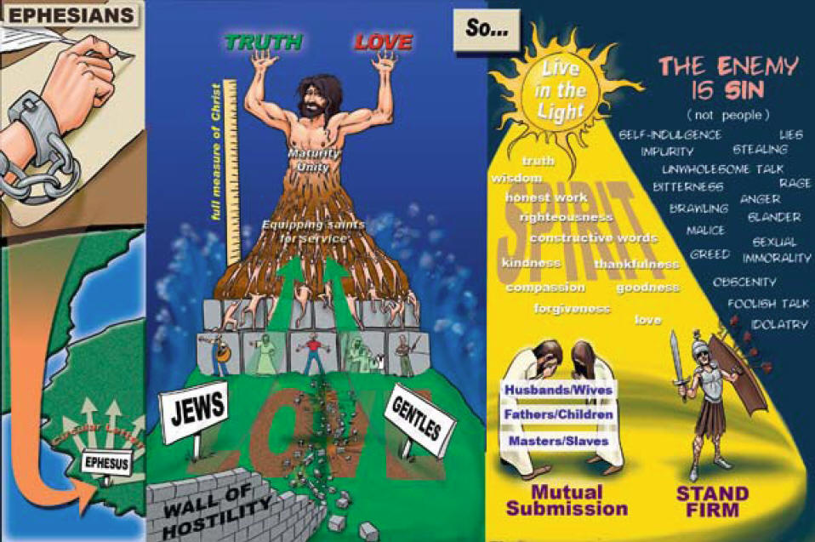
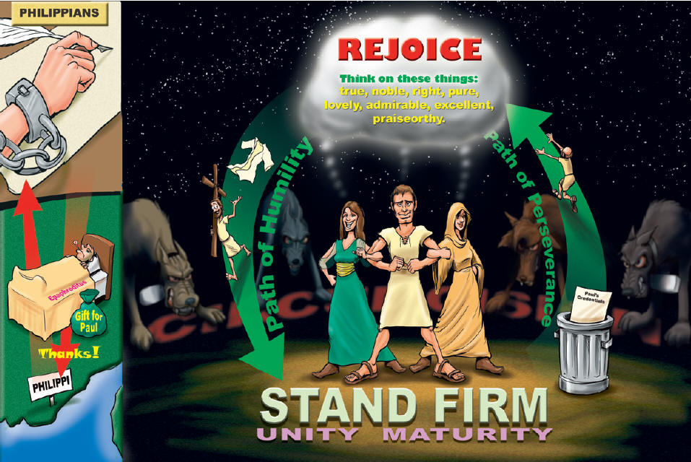



1. Ephesians and Colossians – Twin letters – very similar with slightly different emphasis…
Ephesians – Building the ________ of Christ (theology and practical)
Colossians – Christ the _________ of the Church.
2. Philemon: __________________ from slavery (personal letter to Philemon about Onesimus)
3. Philippians: To Live is _____________ (centrality of Jesus in Christian life)
4. First Timothy: ___________ manual for Church organization.
Second Timothy: _______________ in the Pastoral ministry.
5. Titus: _____________ manual for Church living.
BODY
HEAD
FORGIVENESS
CHRIST
LEADERSHIP
ENDURANCE
CONDUCT

Slide 44


Slide 45

Release
Final imprisonment

Slide 46


Slide 47
Luke probably wrote his Gospel in c.AD60 as Paul was imprisoned and then he wrote the book of Acts in AD.62 – recounting the event up until the end of Paul’s first imprisonment.
The Gospel of Matthew may have been written at same time as Luke (unless you don’t believe the Q theory and Matthew was written earlier).
Peter wrote his two epistles c.AD64 probably when Paul was in Spain.

Slide 48
New Testament Survey
The Spread of Christianity

Slide 49


LESSON 6: The
Epistles and Revelation
i. The Epistles

Slide 50
Writing and Content of The Epistles
AMENUENSIS
Use of an __________________ (secretary) – e.g. Tertius (Romans 16:22), Silas (Silvanus)(1 Thess 1:1) , Sosthenes (1 Cor 1:1), Luke (may have scribed 1,2 Timothy, Titus).
Style of letters
Most of Paul's letters were “___________________.“ (That is they were written for a particular occasion/ happening).
The form is typically (i) Greeting, which includes the name of the author, credentials, blessings, name of recipient; (ii) Body, which was typically responses to problems; (iii) Conclusion, which gave greetings for others in the apostolic band.
OCCASIONAL

Slide 51
Writing and Content of The Epistles
Content of the letters can be divided into two basic areas….
____________________ themes.
Sometimes including prayers.
2. ____________________ issues facing the church.
THEOLOGICAL
PRACTICAL
Correct Theology
Correct Practice

Slide 52

Paul’s Epistle Format
Greeting
Name, Credentials, recipient
Main
Body
Theological
Practical
Conclusion

Slide 53

Comparing Paul’s Letters
The Doctrine of Salvation
The Doctrine of Christ
The Doctrine of End Times
The Doctrine of The Church

Slide 54





ii. Comments on Hebrews and the General Epistles
OLD
A. Hebrews. This is a theology of the _________ Testament in the light of the person and ministry of Christ.
B. James. To a primarily ____________ audience. James provides practical instruction on godly living.
C. 1 and 2 Peter. To Churches under ________________. Practical instruction on unity during opposition. Explains the role of Satan in their persecution.
D. 1,2,3 John and Jude. Written primarily to a _________ church. The doctrine of Christ's humanity are taught and the call to moral purity and love are emphasized.
JEWISH
PERSECUTION
GENTILE

Slide 55


iii. The Prophetic Book
Revelation – Written by John (AD 90s)
Is actually the revelation of Jesus Christ in Church History through to eternity.

Slide 56


(3) Prophetic Book

Slide 57


Slide 58



Slide 59


Slide 60


iv. Summary of Major Themes in the New Testament
A. Time
1.. Linear v. Cyclical.
Linear: Accountability and ultimate _____________.
Cyclical: Biblical history is like a ________________.
2. Time follows expansion of __________________ of God (through evangelism /and missions).
3. Parousia - everything hinges around Christ’s
______________ _________________.
JUDGEMENT
SYMPHONY
THE KINGDOM
SECOND COMING

Slide 61
B. The Messiah
Prophetic fulfillment, yet in a ___________ (Mystery to the lost, revealed to us)
(1 Cor. 2:6-9; Rom. 16:25,26; 1 Pet.1:10-12; Mt. 13:11-17; Eph 5:32).
2. _____________________ system and the cross.
MYSTERY
“That the Gentiles should be fellow heirs, of the same body, and partakers of His promise in Christ through the gospel.” Ephesians 3:6 (The One New Man in Christ)
“But we speak the wisdom of God in a mystery, the hidden wisdom
which God ordained before the ages for our glory.” 1 Cor2:7
THE SACRIFICIAL

Slide 62

Jesus Fulfils the Sacrificial System

Slide 63
C. Grace (undeserved merit)
God’s Riches At Christ’s Expense
1.Polemic (hostile) against
______________ self-righteousness.
”For by grace you have been saved through faith, and that not of yourselves; it is the gift of God, ⁹ not of works, lest anyone should boast.” Ephesians 2:8-9
2. God's acceptance is extended to
_______.
LEGALISTIC
ALL
“(God) who desires all men to be saved and to come to the knowledge of the truth.” 1 Timothy 2:4

Slide 64

D. New Community of God
1. New Covenant and the work of the
______ _______. Acts 2.
2. Neither _____ nor ______. Gal. 3:28.
3. ____________ of heaven. Phil 3:20.
4. Global _______________. 2 Cor 5:20.
HOLY SPIRIT
JEW
GREEK
CITIZENS
AMBASSADORS

Slide 65
E. Missions Summary
The Gospels: Jesus lays down what the Church’s mission is (to spread the Kingdom to every tongue, tribe and nation) and how to accomplish it (in the character and authority of Christ) – Matthew 24:14; 28:19-20
Acts: Account of how the early Church outworks this mission in the power of the Holy Spirit – Acts 1:8
Epistles: Every aspect of how we, as individuals and the Church, can be set free to fulfill His mission – Rom 16:26
Revelation: The certain truth that His mission will be accomplished – a world full of people bearing His image, the Kingdom filling the earth and Christ ruling and reigning with His saints – Rev. 7:9

Slide 66

Destinations of all Apostles
Quote by Tertullian

Slide 67

BLOOD OF MARTYRS
Jerusalem
SEED OF CHURCH
Quote by Tertullian

Slide 68

Condensed Summary

Slide 69

Condensed Summary

Slide 70

Condensed Summary

Slide 71

Condensed Summary

Slide 72


