Slide 1

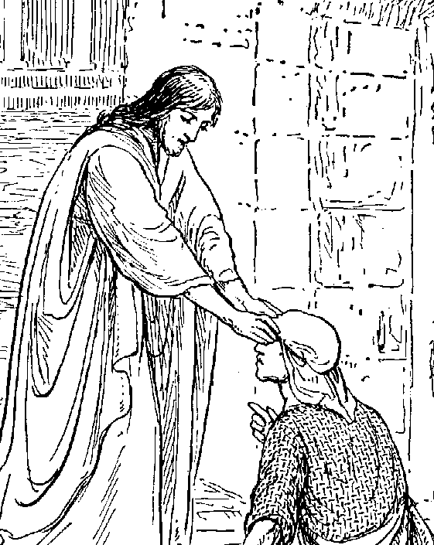
New Testament Survey
Background to the New Testament and the Gospels

Slide 2

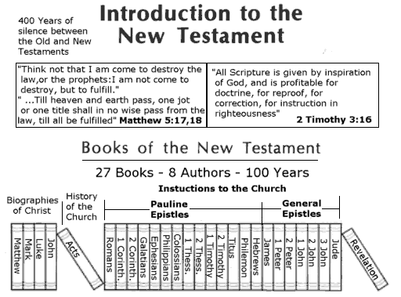
LESSON 1: Introduction to the New Testament

Slide 3
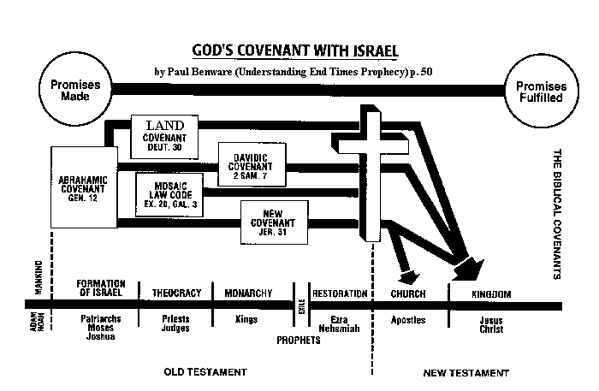
a. Relationship with Old Testament….

Slide 4
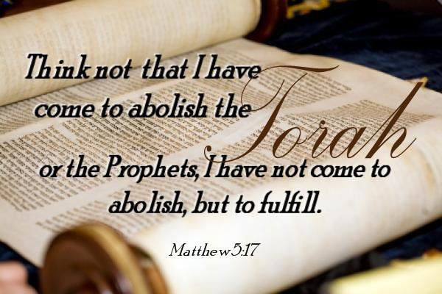
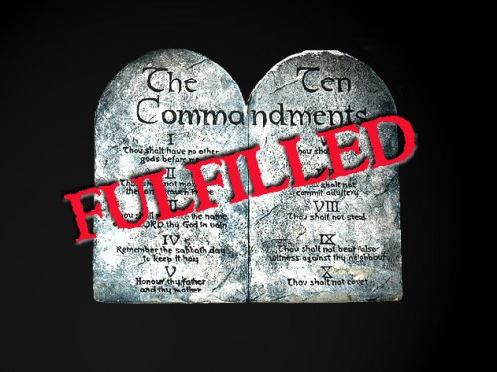
“Filled to
Fullness”
“Correctly
Interpreted”

Slide 5
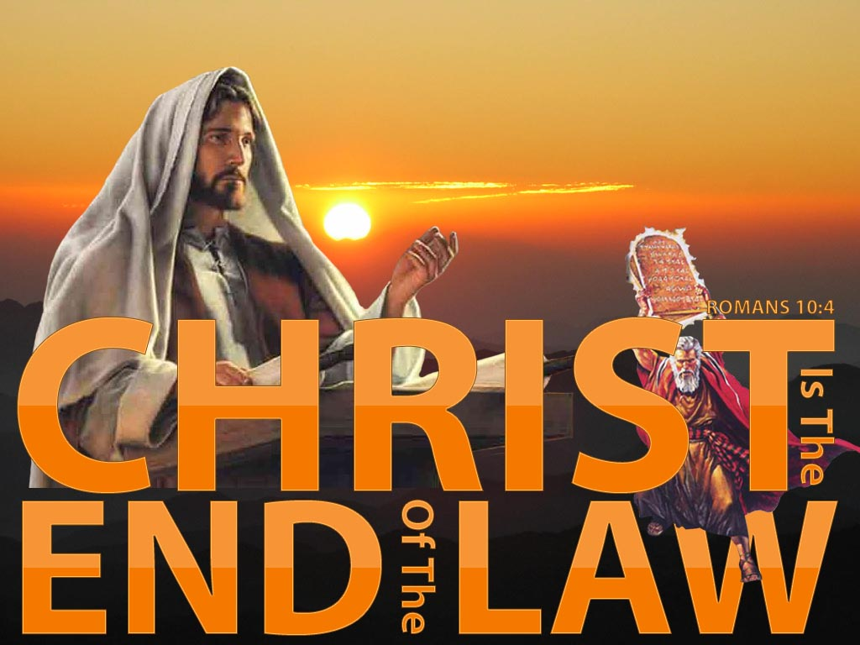
End as in destination not termination
(1) Introduction to the New Testament
a. Relationship with Old Testament….

Slide 6

Only for
Israel
Fulfilled
in Christ
Unchanged but with deeper meaning

Slide 7
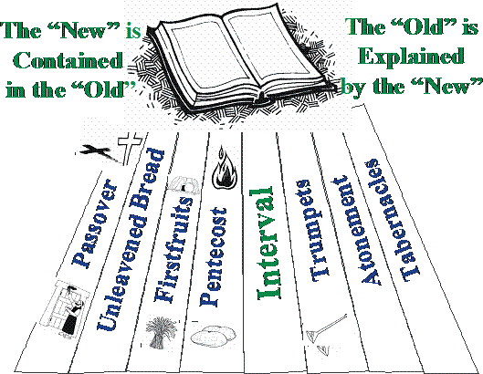

Slide 8
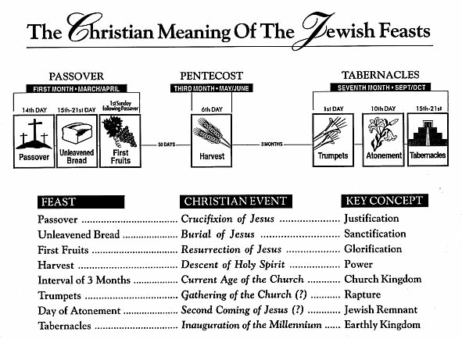

Slide 9
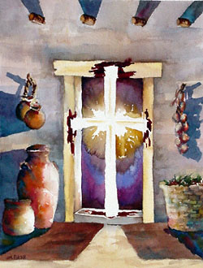
How the Testaments are Related
The ________________ is concealed in the ___________________.
The _______________ is revealed in the _________________.
The term ‘New’ is used NOT in the sense of _______________
the OLD but in the sense of being ______________ and
__________________ the OLD.
New Testament
Old Testament
Old Testament
New Testament
REPLACING
FRESH
FULFILLING

Slide 10
How the Testaments are Related
"Do not think that I came to destroy the Law or the Prophets. I did not come to destroy but to fulfill. For assuredly, I say to you, till heaven and earth pass away, one jot or one tittle will by no means pass from the law till all is fulfilled.”
Matthew 5:17-18 (NKJV)
UNDER
We are not to be ______________ the Law (Romans 2:12; 1 Corinthians 9:20; Galatians 4:21)
nor ______________ it (James 4:11) but
_______ the Law of the Spirit of Life (Romans 8:2)
- This is by _____________ (Romans 3:31)
ABOVE
IN
FAITH

Slide 11
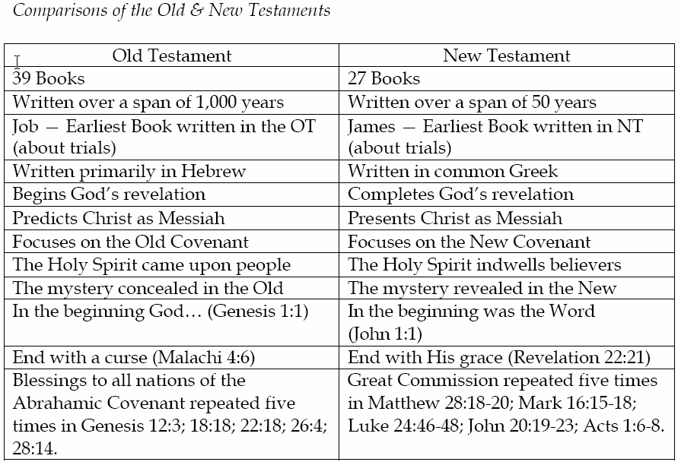
How the Testaments are Related

Slide 12
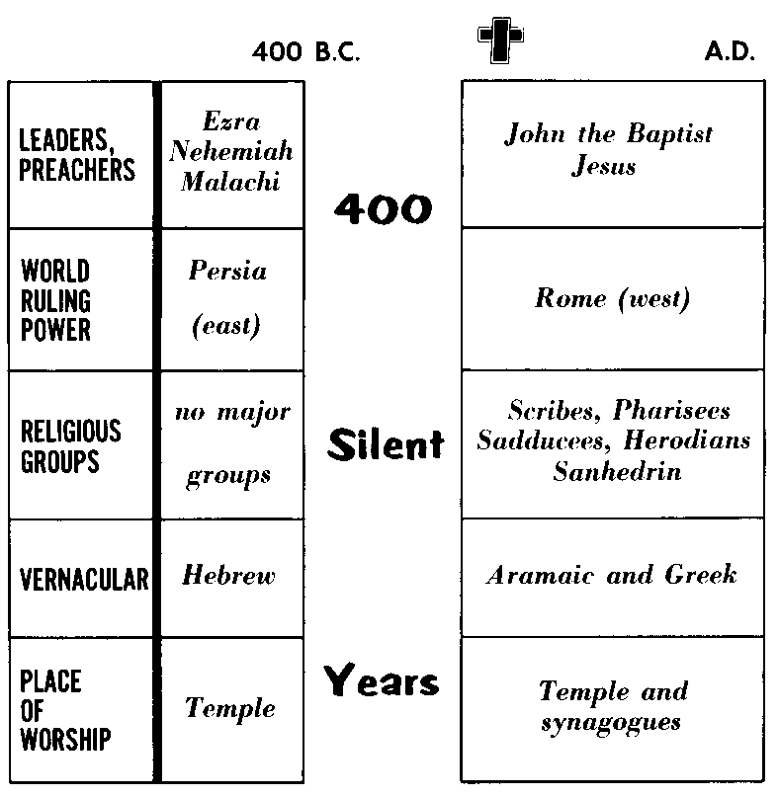
b. Divine Preparation for the New Testament

Slide 13
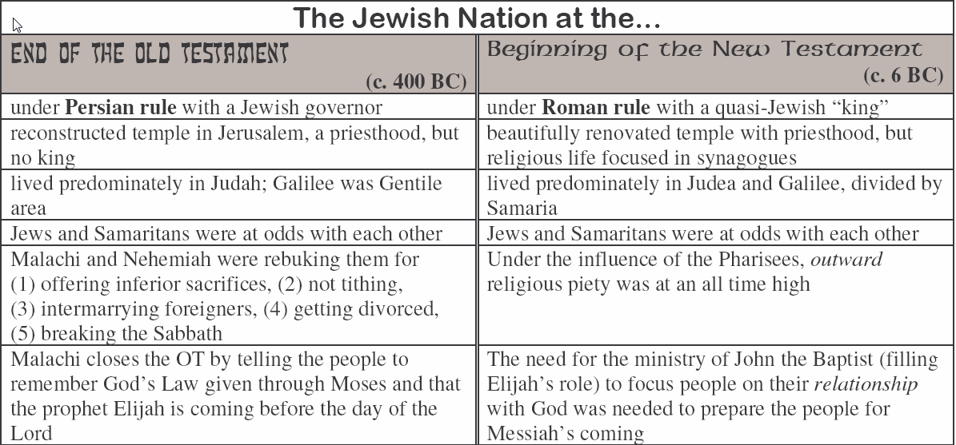

Slide 14
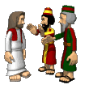
“But when the fullness of the time had come, God sent forth His Son, born of a woman, born under the law, 5 to redeem those who were under the law, that we might receive the adoption as sons.” Galatians 4:4-5 (NKJV)
1. Preparation through the Jewish Nation.
Messianic Expectations
Strong Jewish Groups
Scattered in the nations
From Temple to Synagogues

Slide 15
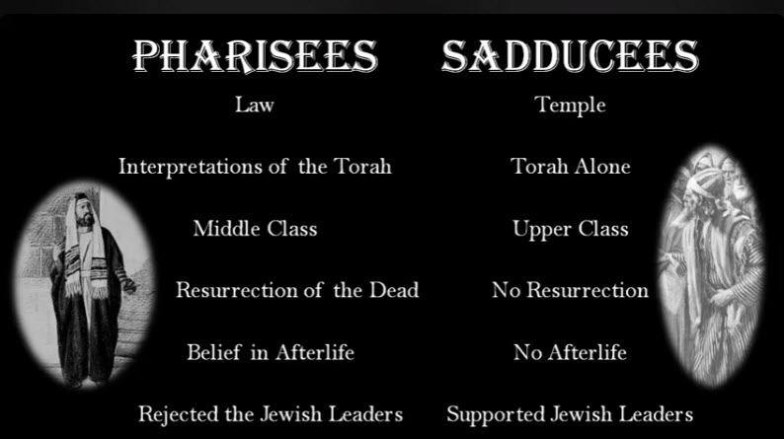
“But when the fullness of the time had come, God sent forth His Son, born of a woman, born under the law, 5 to redeem those who were under the law, that we might receive the adoption as sons.” Galatians 4:4-5 (NKJV)

Slide 16
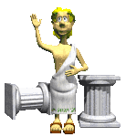
“But when the fullness of the time had come, God sent forth His Son, born of a woman, born under the law, 5 to redeem those who were under the law, that we might receive the adoption as sons.” Galatians 4:4-5 (NKJV)
2. Preparation through the Greeks.
Hellenization
LXX (Septuagint) - ~250BC
- Led to New Testament being written in a common language that could be understood by majority.

Slide 17
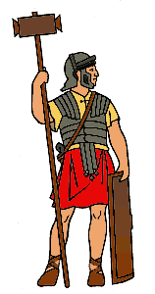
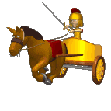
“But when the fullness of the time had come, God sent forth His Son, born of a woman, born under the law, 5 to redeem those who were under the law, that we might receive the adoption as sons.” Galatians 4:4-5 (NKJV)
3. Preparation through the Romans.
Pax Romanus
Roads and Infrastructure
Ensured the speedy spread of early Christianity through established and relatively safe routes.

Slide 18
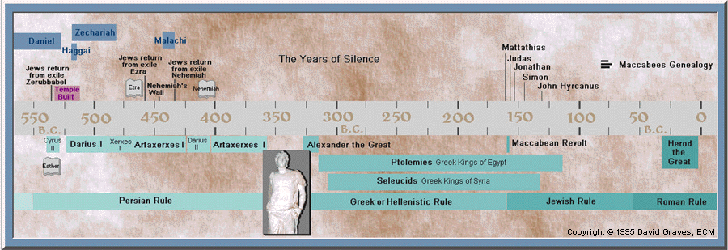
What happened in 400 Silent Years?

Slide 19
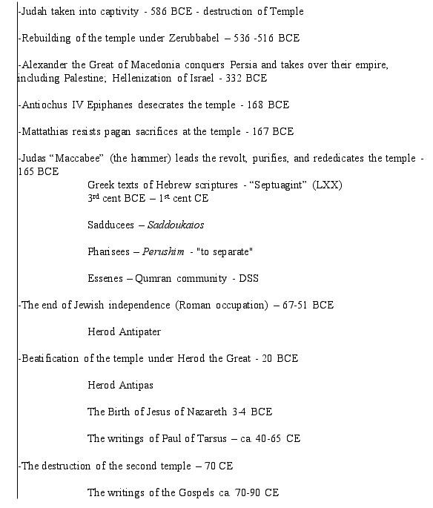

Slide 20
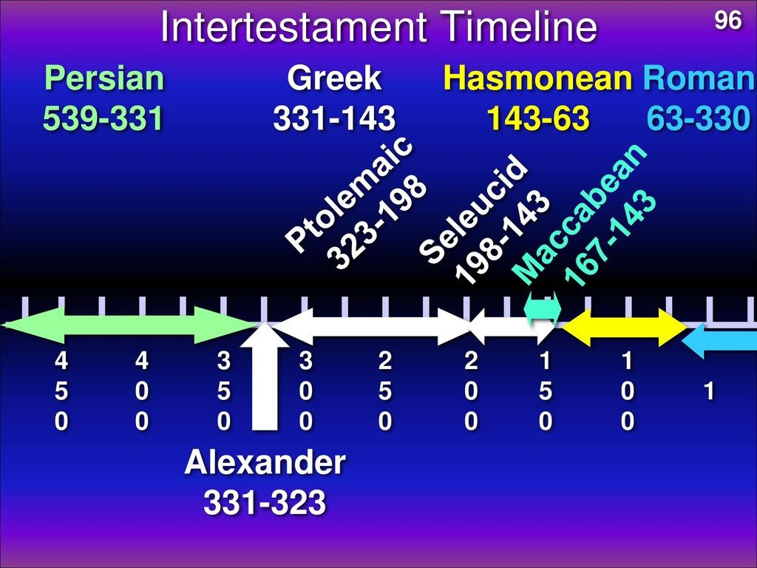

Slide 21
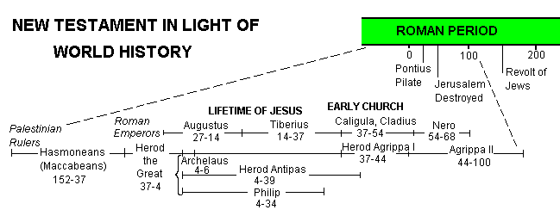

Slide 22
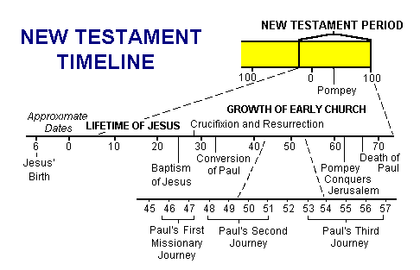
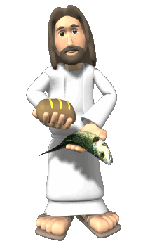
c. Overview of Events in N.T

Slide 23
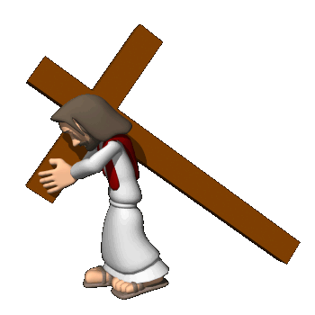


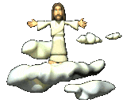

d. An Overview as to Focus
HISTORICAL | The Gospels: Story of the SAVIOUR | Manifestation: Of MESSIAH and KINGDOM
 | Acts: The Acts of the HOLY SPIRIT. | MESSAGE of Saviour. HISTORICAL.
EPISTOLARY | LETTERS on Kingdom LIVING | WORK of Christ. WALK of Christians
PROPHETIC | APOCALYPSE of Jesus. | RETURN of Lord. ETERNAL
Manifestation:
Propagation:
Explanation:
Consummation:

Slide 24
e. New Testament as Scripture
Authorship and authority
Jesus’ pre-_________________ of apostolic writing- John 14:26; 16:13
Apostles’ awareness of the _____________ of their own writing - 1 Cor.14:37
Apostles’ awareness of the inspiration of ______ apostles’ writing - 2 Peter 3:16
Early attestation by “__________ ___________" (the ‘canon’)
AUTHENTICATION
INSPIRATION
OTHER
CHURCH FATHERS

Slide 25
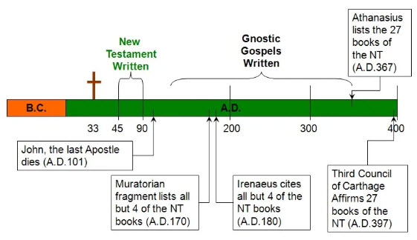
Timeline of NT Canon
Early Date
Apostolic Connection
Intrinsic Soundness
Rejected:2 Peter, 2 & 3 John, Jude and Revelation

Slide 26
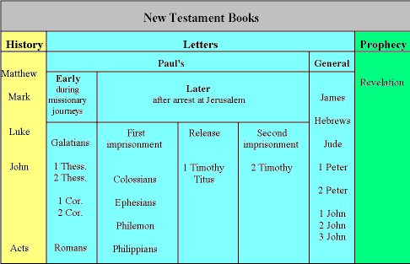


Slide 27
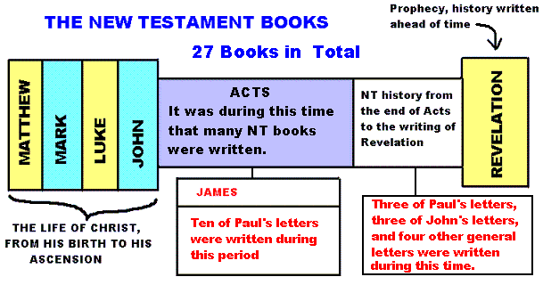

Slide 28
New Testament Survey
Background to the New Testament and the Gospels

Slide 29
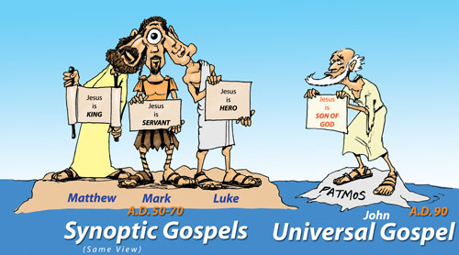
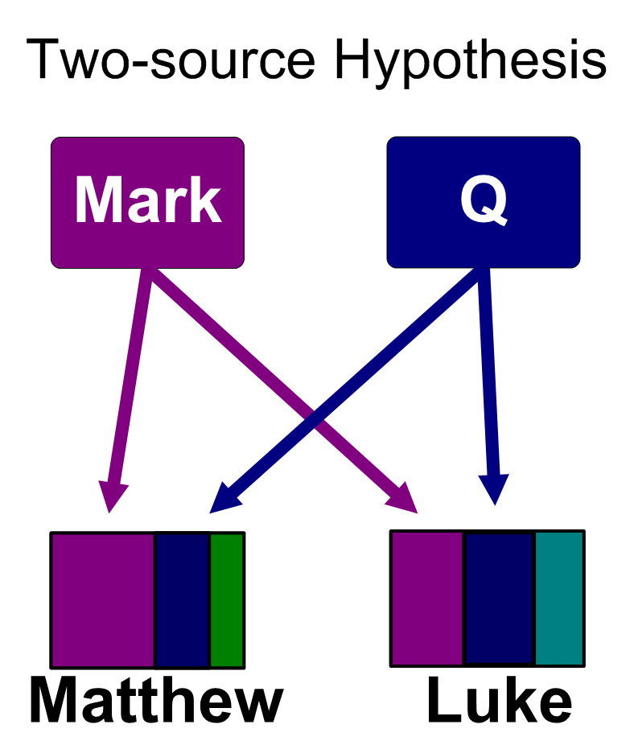
LESSON 2: The Historical Books
a. The Gospels
The Gospels: Acts 1:1-3 gives reason for the Gospels – That is…
TO SHOW THE LIFE AND WORK OF JESUS CHRIST.
SYNOPTIC
The _______________ Gospels = Matthew, Mark, Luke
Q Theory = Matthew, Luke taken from common texts (commonly believed to be Mark and Q).

Slide 30
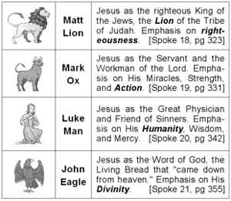
b. The Gospels at a Glance

Slide 31
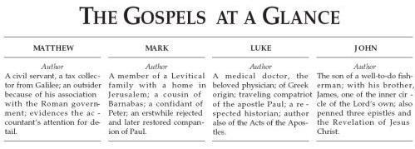

Comparing the Gospels

Slide 32
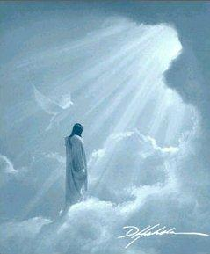
MATTHEW MARK LUKE JOHN
KING SERVANT MAN GOD
LION OX MAN EAGLE
TO JEWS ROMANS GENTILES CHRISTIANS
PASTOR/
TEACHER
APOSTLE EVANGELIST PROPHET
CHOLERIC SANGUINE MELANCHOLY PHLEGMATIC

Slide 33
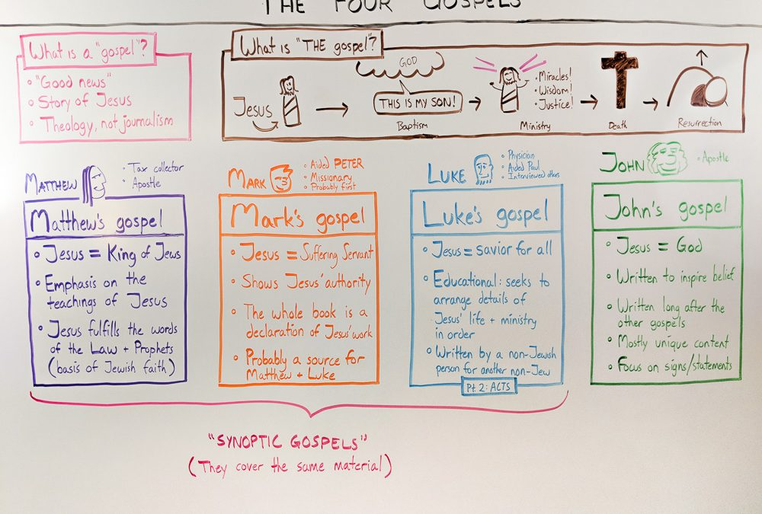

Slide 34
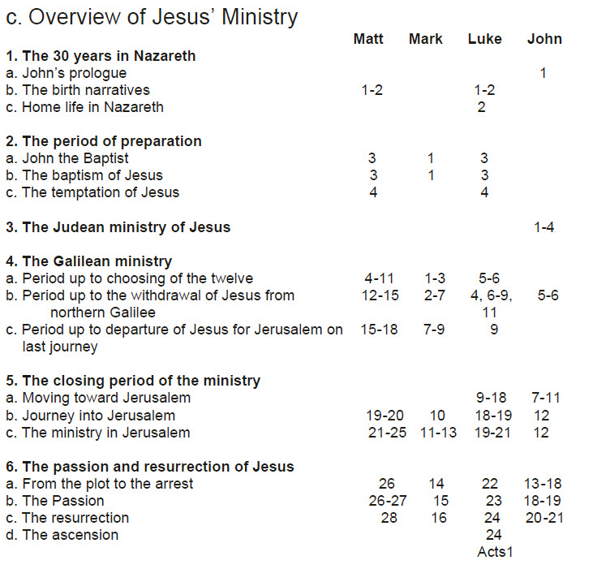
All four gospels record most important events
1
(Inferred)

Slide 35
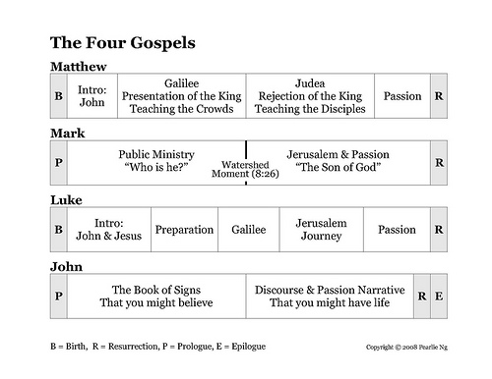
c. Overview of Jesus’ Ministry
“You are
the Christ”
Popularity, Multitudes, Easy Message
Rejection, Few, Hard Message

Slide 36
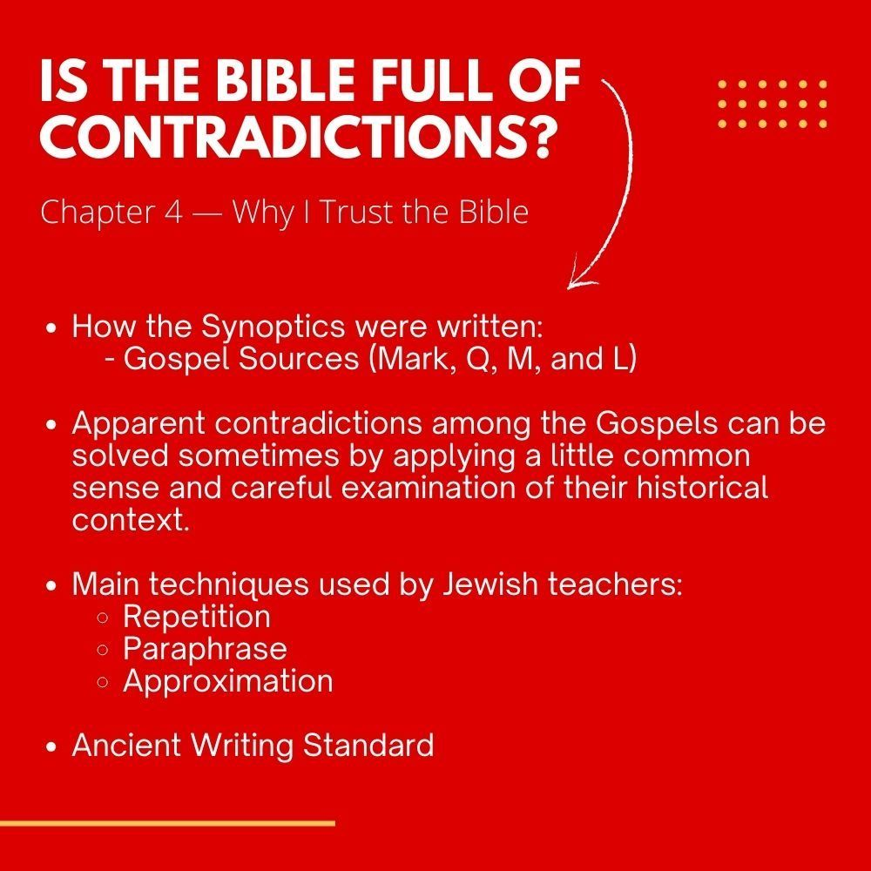
(e.g. into or out of Jericho to heal 1 or 2 blind men? 1 or 2 Gadarene demoniacs?)

Slide 37
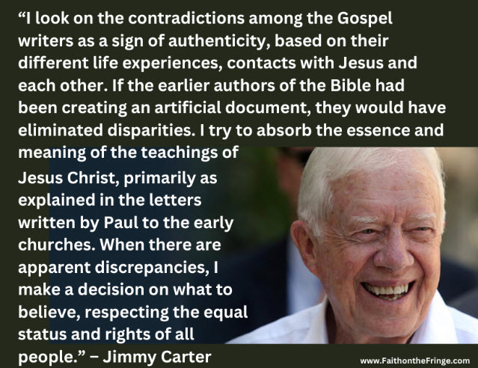
”
Jimmy Carter
Apparent contradictions show early Christian didn’t try to fake the Gospels but that they all had different perspectives and experiences of the same events.

Slide 38
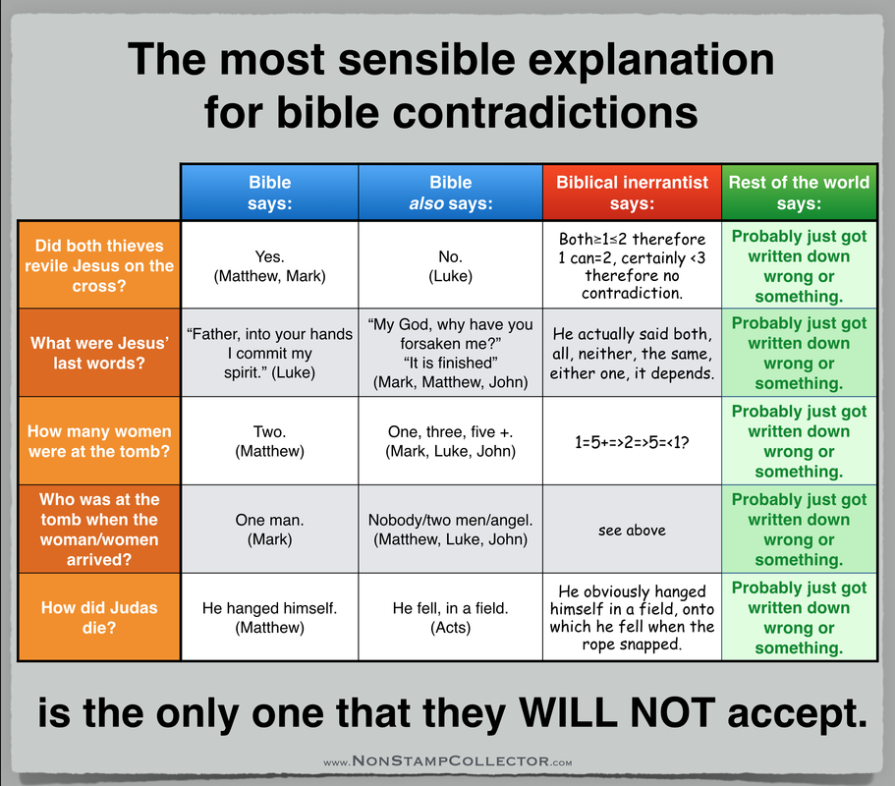

Slide 39
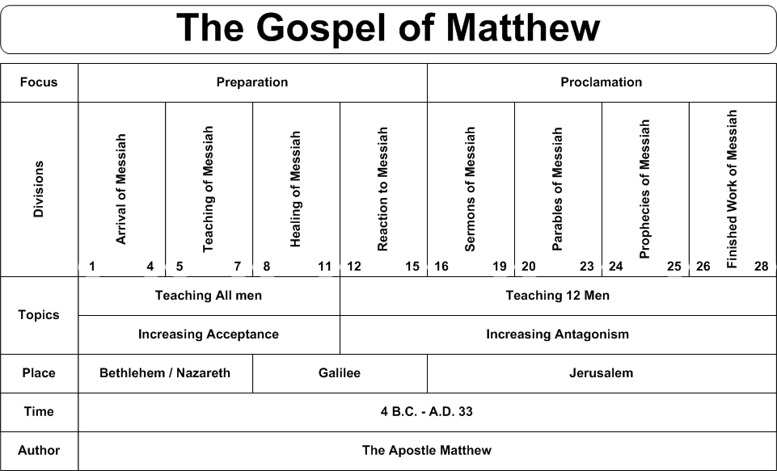
d.

Slide 40
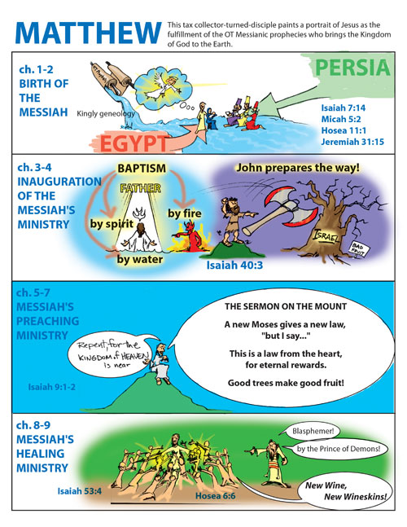

Slide 41
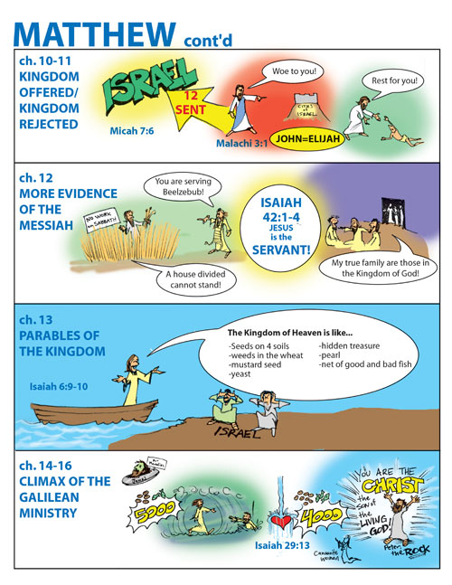

Slide 42
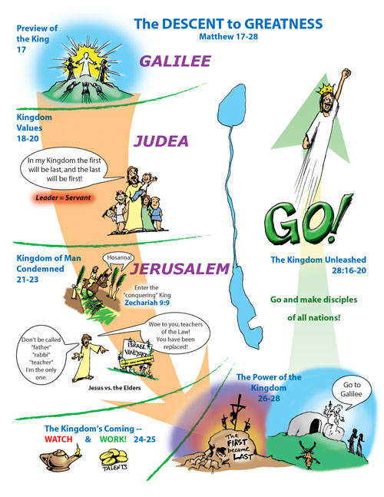

Slide 43
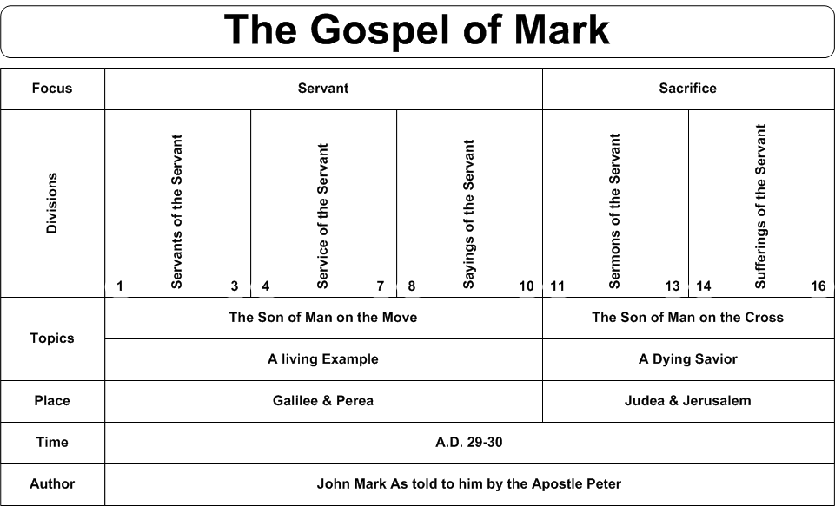
e.

Slide 44
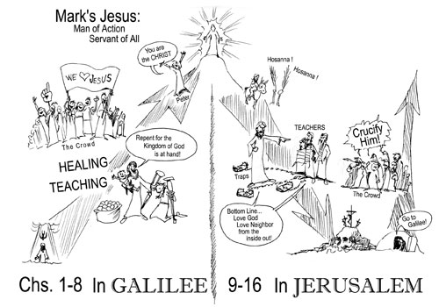

Slide 45
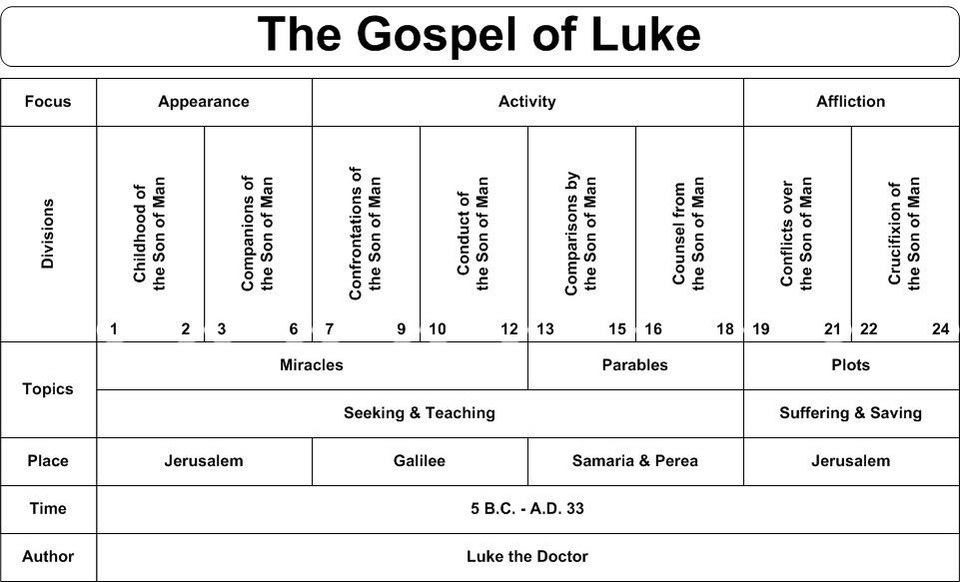
f.

Slide 46
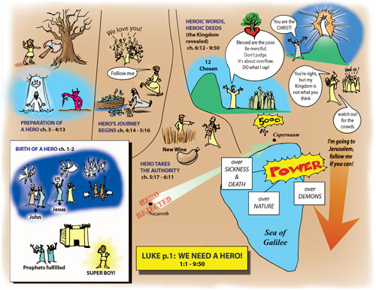

Slide 47
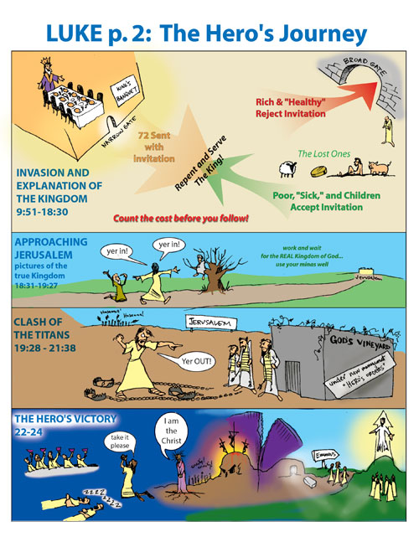

Slide 48
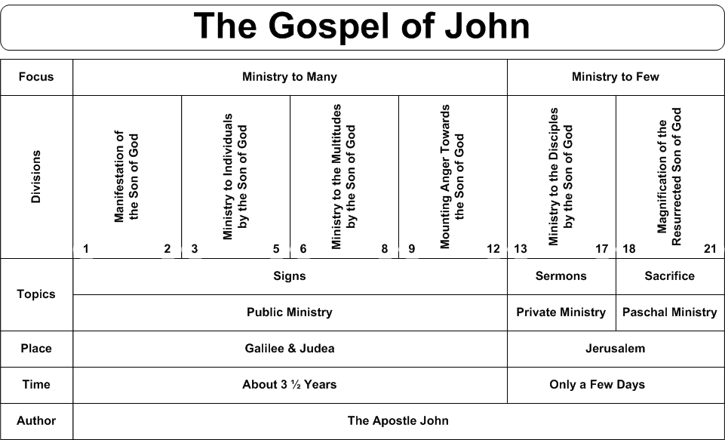
g.

Slide 49
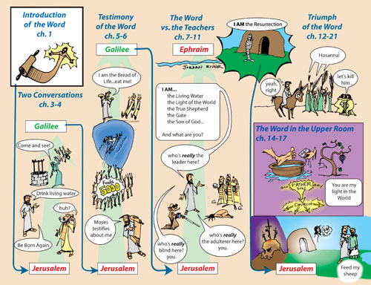

Slide 50
New Testament Survey
Background to the New Testament and the Gospels

Slide 51

LESSON 3: Through the Gospels
We’ve looked at each Gospel now let’s look at the flow of events overall. Those mentioned in all 4 are most important.

Slide 52



i. Jesus’ Birth
and Upbringing
LESSON 3: Through the Gospels
[1] c 6BC - The Birth of Jesus at Bethlehem (Micah 5:2) [2] Presentation at the Temple [3] c 4BC – To Egypt to escape the "massacre of the infants" by Herod the Great – 2nd Moses (Hosea 11:1) [4] c 3BC - Settle in Nazareth in Galilee
[5] c AD6 - The 12 year old Jesus in the Temple [6] c AD6-27 - Nazareth - stays for the next 20 or so years, and follows in his father's footsteps as a carpenter [7] c AD27 - Jesus travels from Nazareth to the River Jordan to be baptised by John the Baptist

Slide 53


Slide 54
Significance of Genealogies
Question:
Why are there two different genealogies for Jesus? One in Matthew 1 and also in Luke, chapter 3? And why does Matthew 1 record Joseph's genealogy? Answer:
The Gospel of Matthew records Joseph’s genealogy and the Gospel of Luke records Jesus’ genealogy through Mary. Matthew points out Jesus' place in the royal succession (Son of David – the Messiah). Luke gives us His actual physical ancestry through Mary's bloodline (Son of Man)

Slide 55

Adam
Back to Abraham showing He is the messiah of God’s people.
Back to Adam showing He is the saviour of all people who believe.
Looking at His line through Joseph which is the royal Davidic line of Judah.
Looking at His line through Mary which is the human line of Jews.

Slide 56
ii. John the Baptist’s Ministry
His Mission: (1) To bring wayward Israelites back to God (Mal 4:5-6)
(2) To prepare the Jewish nation for the Lord’s coming (Isa 40:3)
His Message: Repent! The kingdom of God is near and you’ve got to be ready. Being Abraham’s descendant isn’t enough, you have to get your heart right with God. The Son of God and Lamb of God (cf. Isaiah 53) is coming; he is greater than I and will baptize with the Holy Spirit (those who believe) and with fire (those who don’t believe).
His Method: Baptized Jews, which had never been done. Gentile converts to Judaism, proselytes, were publicly baptized as the final step in their conversion. Jews presumed a close relationship with God because of God’s covenant with their fathers. It was a great act of humility for a Jew to be baptized (the Pharisees and Sadducees wouldn’t submit to it) and it prepared people to follow Jesus (Luke 7:29-30).

Slide 57


Slide 58

They both wore a garment made of animal hair with a leather belt (2 Kin 1:8; Mt 3:4)
They spent long periods in the wilderness (1 Kin 19:3-8; Mt 3:1)
God called them to “prepare the way of the Lord (Mal 4:5; Mt 3:1; Mk 1; Lk 1:17)
They preached repentance and reconciliation for sins (1 Kin 20-27; Lk 3:3)
Both challenged the king for their wickedness (1 Kin 18:17-19; Mt 14:3-4)
The king threatened them with execution because of the king’s wife (1 Kin 19:2; Mt 14:3; Mk 6:19)

Slide 59

iii. Significance of Jesus’ Baptism
· Jesus identifies with Israel, like in his birth, circumcision and presentation at the temple.
· His first public step toward bearing our sin (baptism was for repentance, for which he had no need) and for being our mediator.
· “Fulfill all righteousness” (Mt 3:15) is consistent with Isaiah 53:11-12.

Slide 60


iv.Overview of Jesus’ Ministry
Jesus’ ministry is punctuated by two events:
______________ (identification with humanity) and
______________________________ (resolving human dilemma)
Early Judean Ministry: Year of ___________________.
Galilean Ministry: Year of _____________ (Luke 10:1)
Perean Ministry: Period of _________________.
BAPTISM
CRUCIFIXION/RESURRECTION
OBSCURITY
POPULARITY
REJECTION
Notes:
🌱 The Garden of Three Seasons
Imagine a gardener planting a seed in the quiet soil of winter. No one sees the seed. No one praises the gardener. It’s just cold, dark, and hidden. But the gardener knows what’s coming.
Year One: Obscurity Jesus begins His ministry like that seed—quietly, humbly. He walks the dusty roads of Galilee, speaks to fishermen, turns water into wine at a wedding few remember. The crowds are small. The miracles are whispered. It’s the winter of His ministry—hidden but growing.
Year Two: Popularity Spring bursts forth. The seed sprouts. Crowds gather. The gardener’s work is admired. Jesus feeds thousands, heals the sick, walks on water. People shout His name. They want Him to be king. It’s the season of blossoms—bright, beautiful, and full of hope.
Year Three: Rejection Then comes autumn. Leaves fall. The crowds thin. The gardener watches as the plant is cut down—not because it failed, but because it fulfilled its purpose. Jesus is betrayed, mocked, crucified. The cheers turn to jeers. But the gardener knows: this isn’t the end. It’s the beginning of resurrection.

Slide 61
🌱 The Garden of Three Seasons
Imagine a gardener planting a seed in the quiet soil of winter. No one sees the seed. No one praises the gardener. It’s just cold, dark, and hidden. But the gardener knows what’s coming.
Year One: Obscurity Jesus begins His ministry like that seed—quietly, humbly. He walks the dusty roads of Galilee, speaks to fishermen, turns water into wine at a wedding few remember. The crowds are small. The miracles are whispered. It’s the winter of His ministry—hidden but growing.
Year Two: Popularity Spring bursts forth. The seed sprouts. Crowds gather. The gardener’s work is admired. Jesus feeds thousands, heals the sick, walks on water. People shout His name. They want Him to be king. It’s the season of blossoms—bright, beautiful, and full of hope.
Year Three: Rejection Then comes autumn. Leaves fall. The crowds thin. The gardener watches as the plant is cut down—not because it failed, but because it fulfilled its purpose. Jesus is betrayed, mocked, crucified. The cheers turn to jeers. But the gardener knows: this isn’t the end. It’s the beginning of resurrection.

Slide 62



Early Judean Ministry:
Year of Obscurity
[1] Leaves Nazareth [2] Baptised by John [3] Wilderness Temptation [4] Call first 5 disciples [5] Returns to Galilee - Cana [6] Stays in Capernaum [7] To Jerusalem for Passover (cleansing of Temple, Nicodemus) [8] Judean countryside – Disciples baptise believers [9] Samaritan woman [10] Heals official’s son [11] Preaches in Nazareth
John the Baptist Jailed

Slide 63



Galilean Ministry:
Year of Popularity
[1] To Capernaum – heals madman and Peter’s Mother-in-Law
[2] Travels through Galilee preaching and healing (e.g. Leper) [3] In Capernaum heals paralyzed man and calls Matthew (Levi).
[4] To Jerusalem for Passover – heals crippled man by pool of Bethesda. [5] Return to Galilee – heals man with shriveled hand and many others. [6] Selects 12 and gives sermon on Mount. [7] In Capernaum heals Centurion’s servant.
[8] In Nain brings widow’s son back to life. [9] Second Galilee tour. [10] Calms storm & heals madman. [11] Raises Jairus’ daughter from dead.
John the Baptist Beheaded

Slide 64




Perean Ministry:
Year of Rejection
[1] From Capernaum to Nazareth [2] Rejected in Nazareth [3] Sends 12 to preach [4] 12 return to Capernaum [5] Feeding of 5000 [6] Jesus walks on water [7] Jesus teaches about Bread of Life
[8] Heals gentile woman’s daughter [9] Travels through Galilee to Decapolis [10] Heals deaf and mute & feeds 4000 [11] Crosses Galilee – Pharisees ask for sign [12] In Bethsaida blind man is healed [13] To Caesarea Philippi – Peter’s confession [14] Jesus Transfigured Epileptic healed (sending of 70/72) [15] Jesus pays Temple tax with fish
[16] Samaria – heals 10 lepers but rejected [17] Forgives woman caught in adultery & heals blind man [18] Visits Mary and Martha in Bethany
[19] Withdraws to Bethbara [20] Raises Lazarus [21] Withdraws to Ephraim [22] Withdraws to Perea (children, rich young man)
[23] Heals 2 blind men & converts Zacchaeus [24] Mary anoints Jesus, Triumphal entry [25] Passion week

Slide 65

Traditional view

Slide 66





Alternate view
Passion Week
Factors in Passover High Sabbath (John 19:30-31)
Accounts for “three days, three nights”

Slide 67

Good Friday (traditionally)

Slide 68

By Steve Thomason

Slide 69


v. The Teaching of Jesus
Jesus' identity
1. "I ___" (Exodus 3:14; John 8-10, 14) – Jn 8:12,48-59; 8:12; 10:7,9; 14:6
AM

Slide 70




Slide 71

v. The Teaching of Jesus
Jesus' identity
2. _____________ with God (Jn. 10:30; Jn. 17:5,8)
3. Claims ____________ prerogatives ( to forgive sins (Luke 5:20) and granter of eternal life (Jn. 17:2; 14:6)
4. Unique ____________ Son (Luke 20:41-44; cf Ps. 110:1)
EQUALITY
DIVINE
DAVIDIC

Slide 72





v. The Teaching of Jesus
Jesus’ Sermons (on the Mount)
- Kingdom __________
Jesus’ Parables
- Kingdom ___________
Olivet Discourse
- Kingdom ___________
Upper Room Discourse
- Kingdom ___________
LIVING
TRUTHS
COMING
POWER

Slide 73


Slide 74


